Slide 1
Green Hydrogen Liquefaction by Large-Scale Reverse Brayton Refrigeration
Evan Bean, Akash Kumashi, Guillermo Ribeiro-Vecino

Slide 2
Project Background
Background
Process Design
Economics
Conclusion
Q&A/Appendix
2

Slide 3
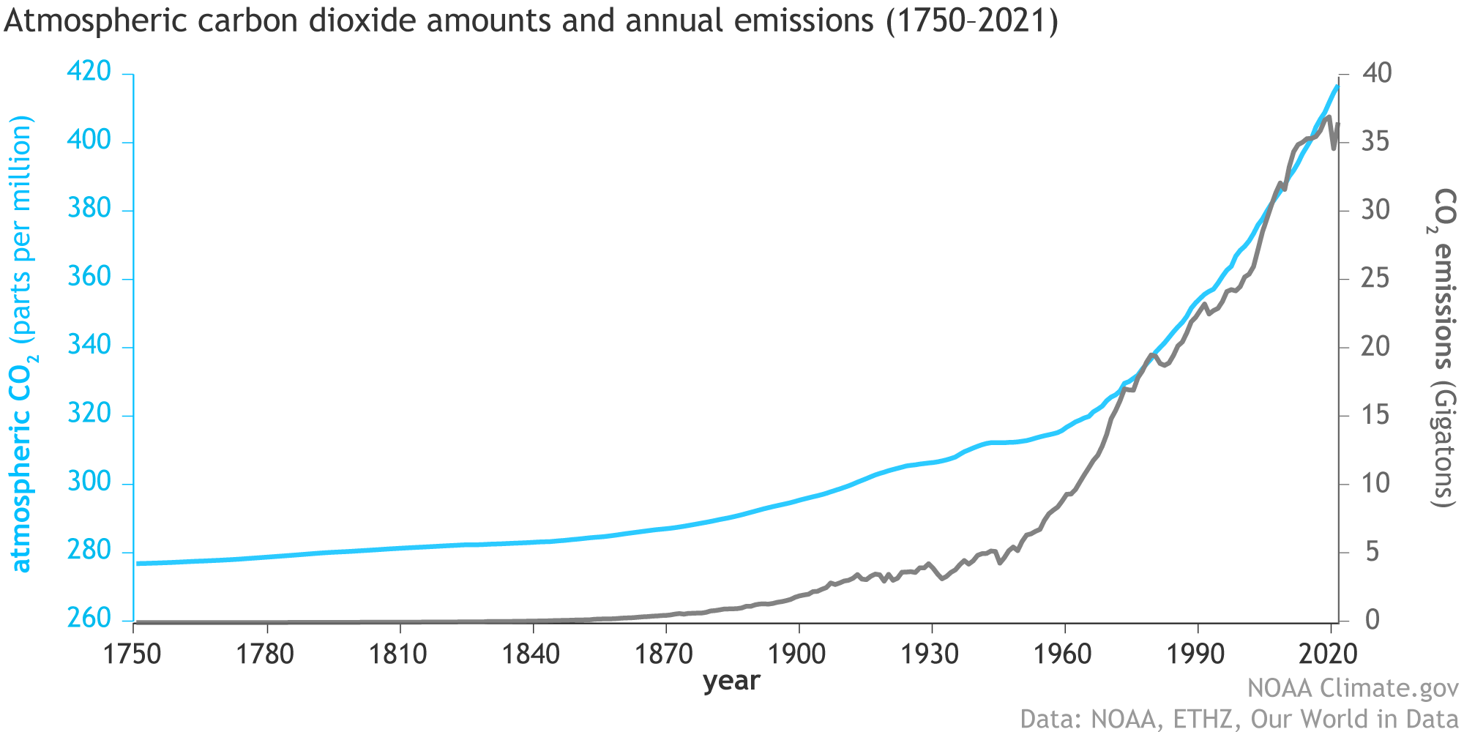
Source: National Oceanic and Atmospheric Association, "www.climate.gov," 23 June 2022. [Online]. Available: https://www.climate.gov/news-features/understanding-climate/climate-change-atmospheric-carbon-dioxide. [Accessed 16 April 2023].
3
Notes:
Guille
Carbon emissions result in accumulation of greenhouse gases in the atmosphere
Script:
Human-caused carbon dioxide emissions have accumulated in the atmosphere, and historical data shows that carbon dioxide concentration correlates strongly with the average global surface temperature. This has created a global anxiety surrounding climate change.

Slide 4
Liquid Hydrogen can replace fossil fuels
$$ΔH=−271\frac{Btu}{mol}$$
$H_{2}+\frac{1}{2}O_{2 } { H}_{2}O$
$10.5 B
$102 B
$13.5 B
$180 B
$91.5 B
$34.5 B
$144 B
$174 B
Source: Morgan Stanley, FT (2022)
Notes:
Guille -
Script:
In order to combust fewer fossil fuels, renewable energy like solar, wind, and hydroelectric power can replace them. However, these energy sources can only be converted into usable energy in the form of electricity. Renewable electricity will not be enough to replace fossil fuels because there will always be a need for on demand combustibles.
Hydrogen provides a clean burning fuel alternative. Combustion of hydrogen only produces water vapor, and zero carbon dioxide.
Renewable energy like solar, wind, and hydroelectric power can replace carbon emitting fossil fuels, in order to combust fewer fossil fuels. However, these energy sources can only be converted into usable energy in the form of electricity.
National governments have set personal benchmarks for green hydrogen because they have realized that their goals for carbon neutrality by 2050 are not possible without clean burning fuels. Renewable electricity will not be enough. By 2030, the International Energy Association (IEA) projects a demand for green hydrogen of over 60 million tons, about one third of the total hydrogen demand projection for that same year. In anticipation of the future importance of green hydrogen in the global energy picture, the industry estimates that $150 billion has already been allocated by governments towards the development of hydrogen production technologies in the form of loan subsidies and research funding. To get a sense of scale, that is the size of the entire global hydrogen market in 2020.

Slide 5
Switching to LH₂ from fossil fuels would decrease annual CO₂ emissions by 1.8B tons
(5 Billion kWh)
913 Billion kWh
2554 Billion kWh
772 Billion kWh
https://www.eia.gov/tools/faqs/faq.php?id=427&t=3
Notes:
Guille -

Slide 6
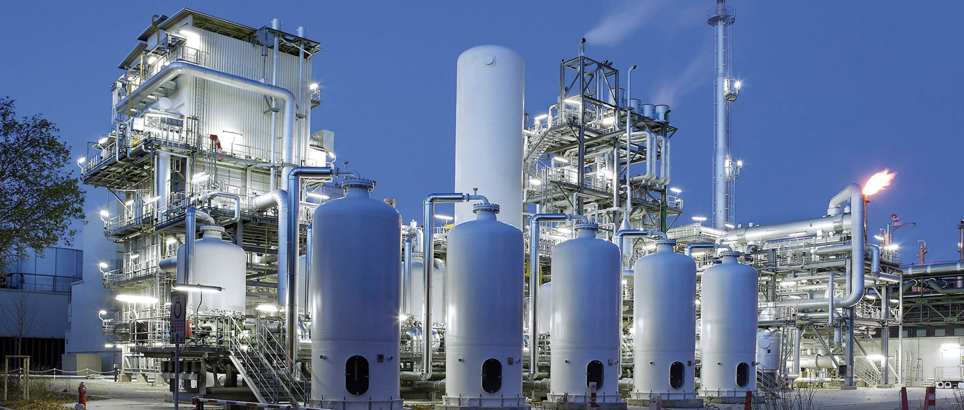
How is Hydrogen Produced?
Steam Methane Reforming: “Grey Hydrogen”
Notes:
Guille:
Previously on slide, now narrated by script:
> 95% of hydrogen production as of 2023
Emits carbon monoxide, dioxide ➔ defeats purpose of using hydrogen as a fuel unless sequestered
Script:
Ninety-five to ninety-nine percent of today’s hydrogen production is accomplished by a process called steam methane reforming, or SMR. SMR splits methane natural gas into hydrogen, carbon monoxide, and carbon dioxide. As a result, SMR has a similar carbon footprint to burning fossil fuels.
Ninety-five to ninety-nine percent of today’s hydrogen production is accomplished by a process called steam methane reforming, or SMR. SMR splits methane natural gas, emitting carbon monoxide and carbon dioxide, which means that burning SMR-produced hydrogen has a similar carbon footprint as burning fossil fuels. For this reason, hydrogen produced via SMR is also called grey hydrogen.

Slide 7
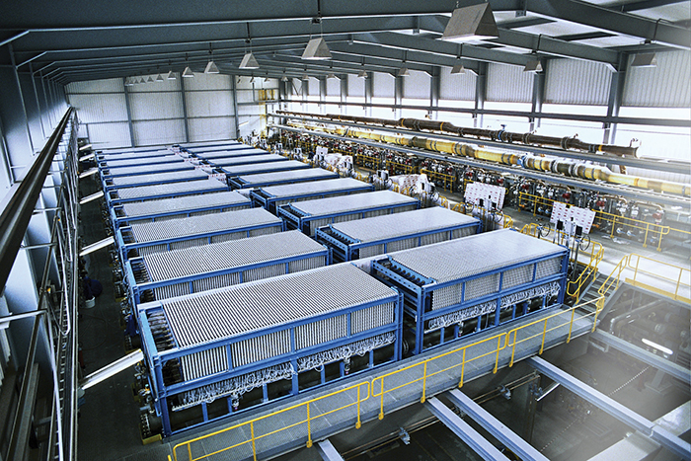
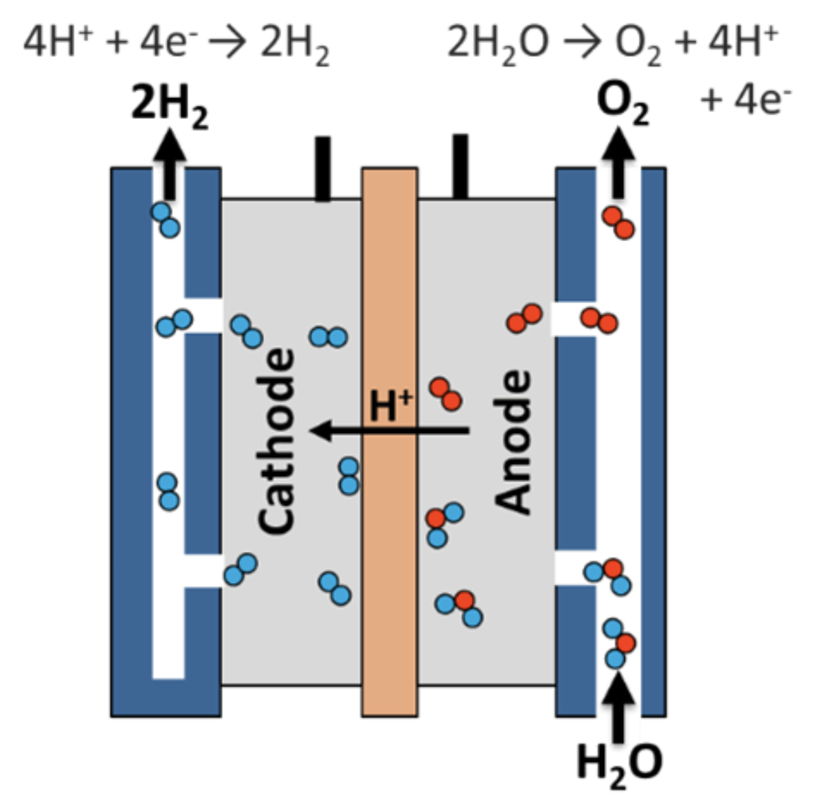
How is Hydrogen Produced?
Water Electrolysis: “Green” Hydrogen
Source: Electrolyzer Technologies for Green Hydrogen - Chemical Engineering | Page 1 (chemengonline.com)
Notes:
Guille:
Previously on slide, now narrated by script:
< 1% of hydrogen production as of 2023
Only emits oxygen, which is sequestered and sold as a byproduct ➔ can be used to decarbonize ammonia production, and as a fuel
Script:
An alternative process to SMR is water electrolysis. In this process, water is split in an electrolytic cell, which functions like a battery in reverse. Hydrogen vapor is produced, with a single byproduct, oxygen vapor. Oxygen is not a greenhouse gas and can be easily sequestered and sold as a byproduct at two cents per pound.
Notice that the reaction taking place in the electrolyzer on the right is exactly the reverse of the reaction that takes place when hydrogen is reacted with oxygen to produce useful energy. This means that water electrolysis does not ever produce any energy. In fact, it can only store electrical energy, and for this process to be completely carbon neutral, the electricity used to run the process must be sourced entirely renewably. Once this is guaranteed, the hydrogen produced by water electrolysis is also called green hydrogen.

Slide 8
Current LH₂ generation pipeline not sustainable
Production of feedstock hydrogen
Hydrogen Liquefaction
$$CH_{4}+H_{2}O CO+3H_{2}$$
$$(CO+H_{2}O CO_{2}+H_{2})$$
Type | Percentage
Steam methane reforming (grey H₂) | 95%
Electrolysis of water (green H₂) | <1%
Other | <5%
$$H_{2}+\frac{1}{2}O_{2} { H}_{2}O$$
Notes:
Guille -

Slide 9
Green H₂ is prohibitively expensive to produce
 | Carbon Intensity (kg CO₂ per kg H₂) | Production Cost ($ per kg H₂)
Green Hydrogen (Electrolysis) | 0 | $6 - $8
Grey Hydrogen (SMR) | 12 | $2 - $3 (cost of LNG)
Blue Hydrogen (SMR + Carbon Capture) | 12 | $4 - $5
Turquoise Hydrogen (Methane Pyrolysis) | < 0 | $2 - $3
DOE Hydrogen ‘Shot’ | 0 | $1
Source: Solena Group
9
Notes:
Guille -
Script:
For this reason, green hydrogen is prohibitively expensive. The table here compares the carbon intensity and the production cost between green hydrogen and grey hydrogen. Carbon intensity is measured in kilograms of carbon dioxide released for every kilogram of hydrogen produced, and the production cost is measured in dollars per kilogram of hydrogen produced.
Evidently, grey hydrogen is two to three times cheaper than green hydrogen, at the expense of emitting twelve kilograms of carbon dioxide for every kilogram of hydrogen that is produced.
The last row in the table refers to an ambitious target set by the Department of Energy, to reduce the cost of green hydrogen to one dollar per kilogram, which is lower than the current cost to produce grey hydrogen. This is the price of green hydrogen which international agencies predict is necessary for twelve percent of global energy demand to be satisfied by green hydrogen in 2050. For the price to lower to this extreme, the price of renewable energy has to drop by ninety percent.

Slide 10
Recent legislation mitigates the cost of green H₂ production
The Inflation Reduction Act of 2022 (U.S.)
Carbon Intensity (kg CO2 emitted per kg H₂) | Inflation Reduction Act Tax Credit ($ per kg H₂)
2.5 – 4 | $0.60
1.5 – 2.5 | $0.75
0.45 – 1.5 | $1.00
0.00 – 0.45 | $3.00
Source: The Inflation Reduction Act of 2022, Section 45V
Notes:
Guille -
Script:
In order to stimulate private investment into green hydrogen production, a provision in the Inflation Reduction Act that was signed by President Biden last year offers tax credits for hydrogen plants. The tax credits are tabulated here.
First, consider a hydrogen plant producing one hundred percent of its hydrogen by way of water electrolysis, with one hundred percent of the electricity used to run that plant being renewably sourced. These are the upstream specifications of the green hydrogen liquefaction plant that we designed. In this case, the plant would emit zero kilograms of carbon dioxide for every kilogram of hydrogen that is produced. The plant would receive a generous tax credit of three dollars per kilogram of hydrogen produced. This is more than the cost of grey VAPOR hydrogen produced by steam methane reforming.
Next, recall from the previous slide that a hydrogen plant that produces one hundred percent of its hydrogen by way of steam methane reforming produces 12 kilograms of carbon dioxide for every kilogram of hydrogen that is produced. This plant would receive no tax break, because it does not reduce carbon emissions.

Slide 11
April 2022
Air Liquide
Las Vegas, Nevada
Air Liquide Las Vegas LH₂ Plant: 30 metric tons per day, $250M Total Capital Investment
Notes:
Guille -
April 2022: Air Liquide Las Vegas hydrogen liquefaction facility began operating. Liquefy 30 metric tons per day, steam methane reforming. Primarily consumed by hydrogen fueling stations in California. Total $250M investment as part of 8B Euro commitment to green hydrogen production chain through 2035. By 2030 aims to have 3 GW or approximately 450 MTPD electrolytic hydrogen production.
Service the California hydrogen fuel cell electric vehicle market.
Script:
(segueing into hydrogen liquefaction):
After being produced, there is the issue of hydrogen storage. Hydrogen liquefaction plants will be ubiquitous and necessary for the hydrogen supply chain much in the same way natural gas liquefaction (LNG) plants exist today, since hydrogen fueling stations and transport by sea will require the higher energy density of liquid hydrogen. Recently, hydrogen liquefaction plants have proliferated along with electrolysis plants, in anticipation of the larger role hydrogen will occupy in the global economy.
(now current slide):
For example, in April of last year Air Liquide began operating a two hundred fifty million dollar hydrogen liquefaction facility that liquefies thirty metric tons of hydrogen per day, to be primarily consumed by hydrogen fueling stations in California. Actually, all of the hydrogen sourced for this liquefaction plant is produced by SMR as of this moment. The idea is to progressively switch the plant to green hydrogen as it becomes more economically feasible, as part of Air Liquide’s eight billion euro commitment to the green hydrogen production chain through 2035. Their stated goal is to have three gigawatts, or approximately four hundred fifty metric tons per day, of electrolytic hydrogen production capability by 2030.

Slide 12
Location | Operator | Capacity (MTPD) | Year Constructed
Kimitsu, Japan | Nippon Steel Corporation | 0.2 | 2004
Saggonda, India | Andrha sugars | 1.2 | 2004
Osaka, Japan | Iwatani | 10 | 2006
Leuna, Germany | Linde | 5 | 2008
Chiba, Japan | Iwatani | 5 | 2009
Yamaguchi, Japan | Iwatani and Tokuyama | 5 | 2013
Akashi, Japan | Kawasaki Heavy Industries | 5 | 2014
Yamaguchi, Japan | Iwatani and Tokuyama | 10 | 2017
POH, Australia | HESC | 0.25 | 2020
Las Vegas, USA | Air Liquide | 30 | 2020
Leuna, Germany | Linde | 10 | 2021
La Porte, USA | Air Products | 27.2 | 2021
La Porte, USA | Praxair | 27.2 | 2021
California, USA | Air Products | 10 to 30 | 2021
Ulsan, Korea | Hyosung and Linde | 13 | 2022
Massena, New York | Air Products | 35 | ongoing
2023 CBE Senior Design |  | 45 | 2025
12
Source: S. M. U. C. e. a. Saif Al Ghafri, "hydrogen liquefaction: a review of the fundamental physics, engineering practice, and future opportunities," Energy & Environmental Science, 2022.
Notes:
Guille -
Current global liquefaction capacity: 350 MTPD (as of 2022)
Script:
This table illustrates the recent acceleration in the development of hydrogen liquefaction plants, particularly larger scale plants on the order of 30 metric tons per day.
Of particular note is the Air Products plant [point to row]. Air Products is spending five hundred million dollars to build a thirty five metric tons per day green liquid hydrogen plant in Massena, New York. This is a special plant because it is producing its hydrogen entirely via water electrolysis. It will produce electricity for water splitting from a hydroelectric dam along the St. Lawrence River.

Slide 13
Cryogenic Liquefaction Process Design
Background
Process Design
Economics
Conclusion
Q&A/Appendix
13

Slide 14
Ortho-Para Conversion complicates H₂ liquefaction
Regular hydrogen is a mixture of two spin isomers: orthohydrogen and parahydrogen
H
H
H
H
“orthohydrogen” (o-H₂)
“parahydrogen” (p-H₂)
As hydrogen is cooled, o-H₂ reacts spontaneously and exothermically to form p-H₂
o-H₂ p-H₂ + (energy)
Product LH₂ should be
as close to pure p-H₂ as possible
to prevent boiloff/explosions
(-414 °F, 52 psia, pressurized liquid)
Notes:
Akash -
An important consideration in the process design is a quantum mechanical effect that arises in the hydrogen molecule. The hydrogen molecule has two spin isomers, ortho and para hydrogen. Para hydrogen is more stable than ortho hydrogen. When hydrogen is liquefied, orthohydrogen spontaneously converts to parahydrogen, releasing unwanted energy that vaporizes the liquid hydrogen. In order to prevent this, hydrogen has to be pre-converted in catalytic converters inserted in two heat exchangers.
reasonably good
diagram is bad. tell them difference
detail boiloff problem
Script:
Additionally,

Slide 15
Cryogenic Liquefaction Process Design has two main components
1) Design
2) Operation
Metric
Upstream
Minimum Approach Temperature
ROI
+
Precooling
Power Source
Energy Efficiency
Refrigeration Cycle
Capacity
Refrigerant
Notes:
Akash -
Script:
In working through this design project, our team learned that there are two broad categories that shape the structure of a process in a cryogenic liquefaction plant. Those are plant design and plant operation. Combining a specific design configuration and a specific operation configuration leads to an observable metric of performance, such as a return on investment figure, or an energy efficiency figure. Now: to give context to our choice of configuration, we will briefly go through the components of cryogenic plant design and cryogenic plant operation.

Slide 16
Component 1 of cryogenic liquefaction process design
1) Design
Make H₂ vapor feedstock in house?
Buy H₂ vapor feedstock from producer?
Upstream
Precooling
Liquid Nitrogen? Mixed refrigerant?
Refrigeration Cycle
Reverse Brayton cycle, Claude cycle,
LINDE cycle
Refrigerant
Neon? Helium? Hydrogen? Mixed refrigerant?
Notes:
Akash -
Script:
Cryogenic plant design is dependent on four main parameters. These are the upstream sourcing of hydrogen feedstock, the choice of refrigerant and precooling agents, and the specific refrigeration cycle used.
It is important to decide whether it is worth it to externally purchase H2 feedstock or make it. In order to have more control over the process, most H2 liquefaction plants create their hydrogen feedstock using the techniques we mentioned before, such as SMR.
All cryogenic processes have a precooling step to take the feedstock to a sufficiently low temperature in the cheapest way possible, before further cooling is performed. This is usually accomplished by using cheap, externally purchased liquid nitrogen, although some recent, conceptual plant designs contain an additional refrigeration loop with mixed composition refrigerants.
Most importantly, all cryogenic processes have to make a choice of refrigeration cycle to use. There are two main refrigeration cycles used in cryogenic liquefaction processes. These are the Reverse Brayton cycle and the Claude cycle.
(Figures of both)
In the literature, these cycles are used in different cases. In general, the rule of thumb is that Claude cycles are selected for low plant production capacity, while Reverse Brayton cycles are
selected for medium plant production capacity. This heuristic oversimplifies the complexities of liquefaction process design and is the subject of a later sensitivity analysis that the design group performed.
Lastly, the choice of refrigerant is generally a simple one, and is deeply connected to the refrigeration cycle used. In the literature, hydrogen is generally selected as the refrigerant with a Claude cycle, and
Neon or Helium are generally selected as the refrigerant with a Reverse Brayton cycle. Again, detailed analyses have not been performed on Claude cycles with Neon or Helium as refrigerants or vice versa.
A complicating factor to current liquefaction process design is that 50% of the world’s Neon is sourced from Ukraine. Due to the current war in Ukraine, Neon price has soared, and it may be wise for future cryogenic liquefaction designs to build plants that don’t rely on Neon to deliver refrigeration.

Slide 17
Component 2 of cryogenic liquefaction process design
2) Operation
Has to do with efficiency of heat transfer in heat exchangers
Minimum Approach Temperature
Power Source
Regular grid electricity or green grid electricity?
Solar/Wind/Other renewables only intermittently available
Capacity
5 – 100 tonnes LH₂ per day
Notes:
Akash -
Cryogenic Plant operation is dependent on three main parameters. These are the minimum approach temperature in the Heat Exchangers, the plant’s power source (used to power the compressors of the process), and the plant’s production capacity.
The minimum approach temperature in heat exchangers describes the smallest temperature difference between the cold and hot streams in the exchanger. A lower minimum approach temperature increases the efficiency of heat transfer. Generally, in cryogenic liquefaction plants, the minimum approach temperature is constrained to less than 5 degrees F. However, extremely small min approach temperatures necessitate large heat exchangers, increasing capital cost. This is explored later, in the equipment design section of our presentation.
Next, a decision on the plant’s power source must be made. Regular grid electricity, which is produced through the combustion of natural gas, is the cheapest option. However, this is not “renewable.” Green grid electricity, which is produced through a combination of solar, wind, and other energy sources is only intermittently available and costs a premium.
Lastly, plant operation is dependent on chosen Plant capacity. Chosen plant capacity affects capital cost of equipment, but also can cause different process thermodynamics at different production capacities.

Slide 18
H₂ Liquefaction process design performance metric
Metric
$\frac{Earnings}{Total Capital Investment}$ [%]
ROI
$\frac{Σ\left(Compressor power reqs.\right)−Σ\left(Turboexpander wk. extracted\right)}{LH_{2} Product flowrate}$ [kW/kg]
Specific Power
$\frac{Specific Power}{Minimum Specific Power}$ [%]
Energy Efficiency
Notes:
Akash-
The combination of design and operation choices for a cryogenic liquefaction plant can be assessed using two metrics of performance: the plant’s ROI and the plant’s specific power requirement (which is a measure of energy efficiency). In general, a higher energy efficiency is associated with high capital cost of equipment and thus, a lower ROI. This is the subject of a later sensitivity analysis.

Slide 19
Our Design
Our Operation
Our Performance
Upstream
Minimum Approach Temperature
ROI
Electrolysis of Water
<5 ºF
16.57% in Yr 3. of Operations
Precoolant
+
Energy Efficiency
Power Source
Liquid Nitrogen
6.2 kW req/kg LH2 prod
Green grid electricity
Refrigeration Cycle
Production Capacity
Reverse Brayton
45 tonnes LH₂/day
Refrigerant
Neon
Notes:
Akash -
Our physical H2 liquefaction process design is differentiated by 2 significant choices: The first, our commitment to a fully green process- this means that our feedstock H2 is produced through electrolysis of water and our power source is green grid electricity. The second, large-scale Reverse Brayton refrigeration. Traditionally, Reverse Brayton refrigeration has only been realized for H2 liquefaction processes around 20 MTD. Our 45 MTD plant would be the largest in the world.
These process configuration choices result in an energy efficiency of 6.2 kW required/kg LH2 liquefied , which is competitive with theoretical plant designs

Slide 20
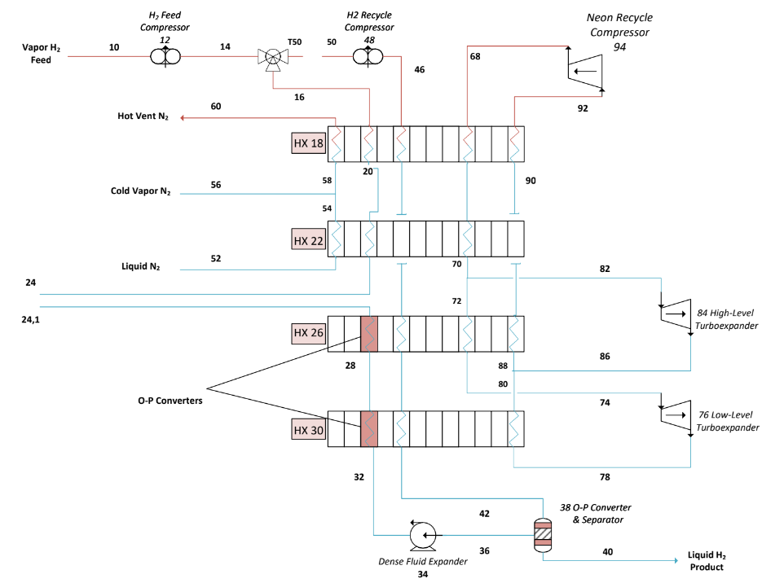
Using ASPEN PLUS to model chosen Process Design
80K Adsorber
Notes:
Evan -
Our hydrogen liquefaction process relies on two refrigeration loops: a hydrogen refrigeration loop and a neon refrigeration loop which we will go through now.
######
hydrogen is precompressed and sent through a series of heat exchangers where it is cooled by saturated nitrogen vapor and liquid nitrogen until it approaches nitrogen’s lowest available temperature. While it would be possible to expand hydrogen after this point to cool it to its boiling point, substantial compressor power and electricity would be required. This process offers a more efficient solution.
Nitrogen is used to cool a neon refrigeration loop which reaches temperatures below Liquid Nitrogen through precompression and expansive cooling. By using this loop, the energy efficiency of the process is increased.
In heat exchangers 26 and 30, the temperature of the hydrogen stream is low enough to begin catalysis of the ortho to para spin isomerization reaction. Heat exchangers play the double function of coolers and reactors for the hydrogen stream, a topic that we will discuss more later.
Hydrogen is then sent to a dense fluid expander, which expands the gaseous stream to a vapor liquid equilibrium that is phase-separated through a catalytic knockout drum. Gas is returned through the heat exchangers as a coolant until it is recompressed and mixed with the feed stream. Liquid flows through a packed bed of catalyst within the knockout drum where residual ortho Hydrogen is converted and then delivered to a cryogenic storage tank.

Slide 21
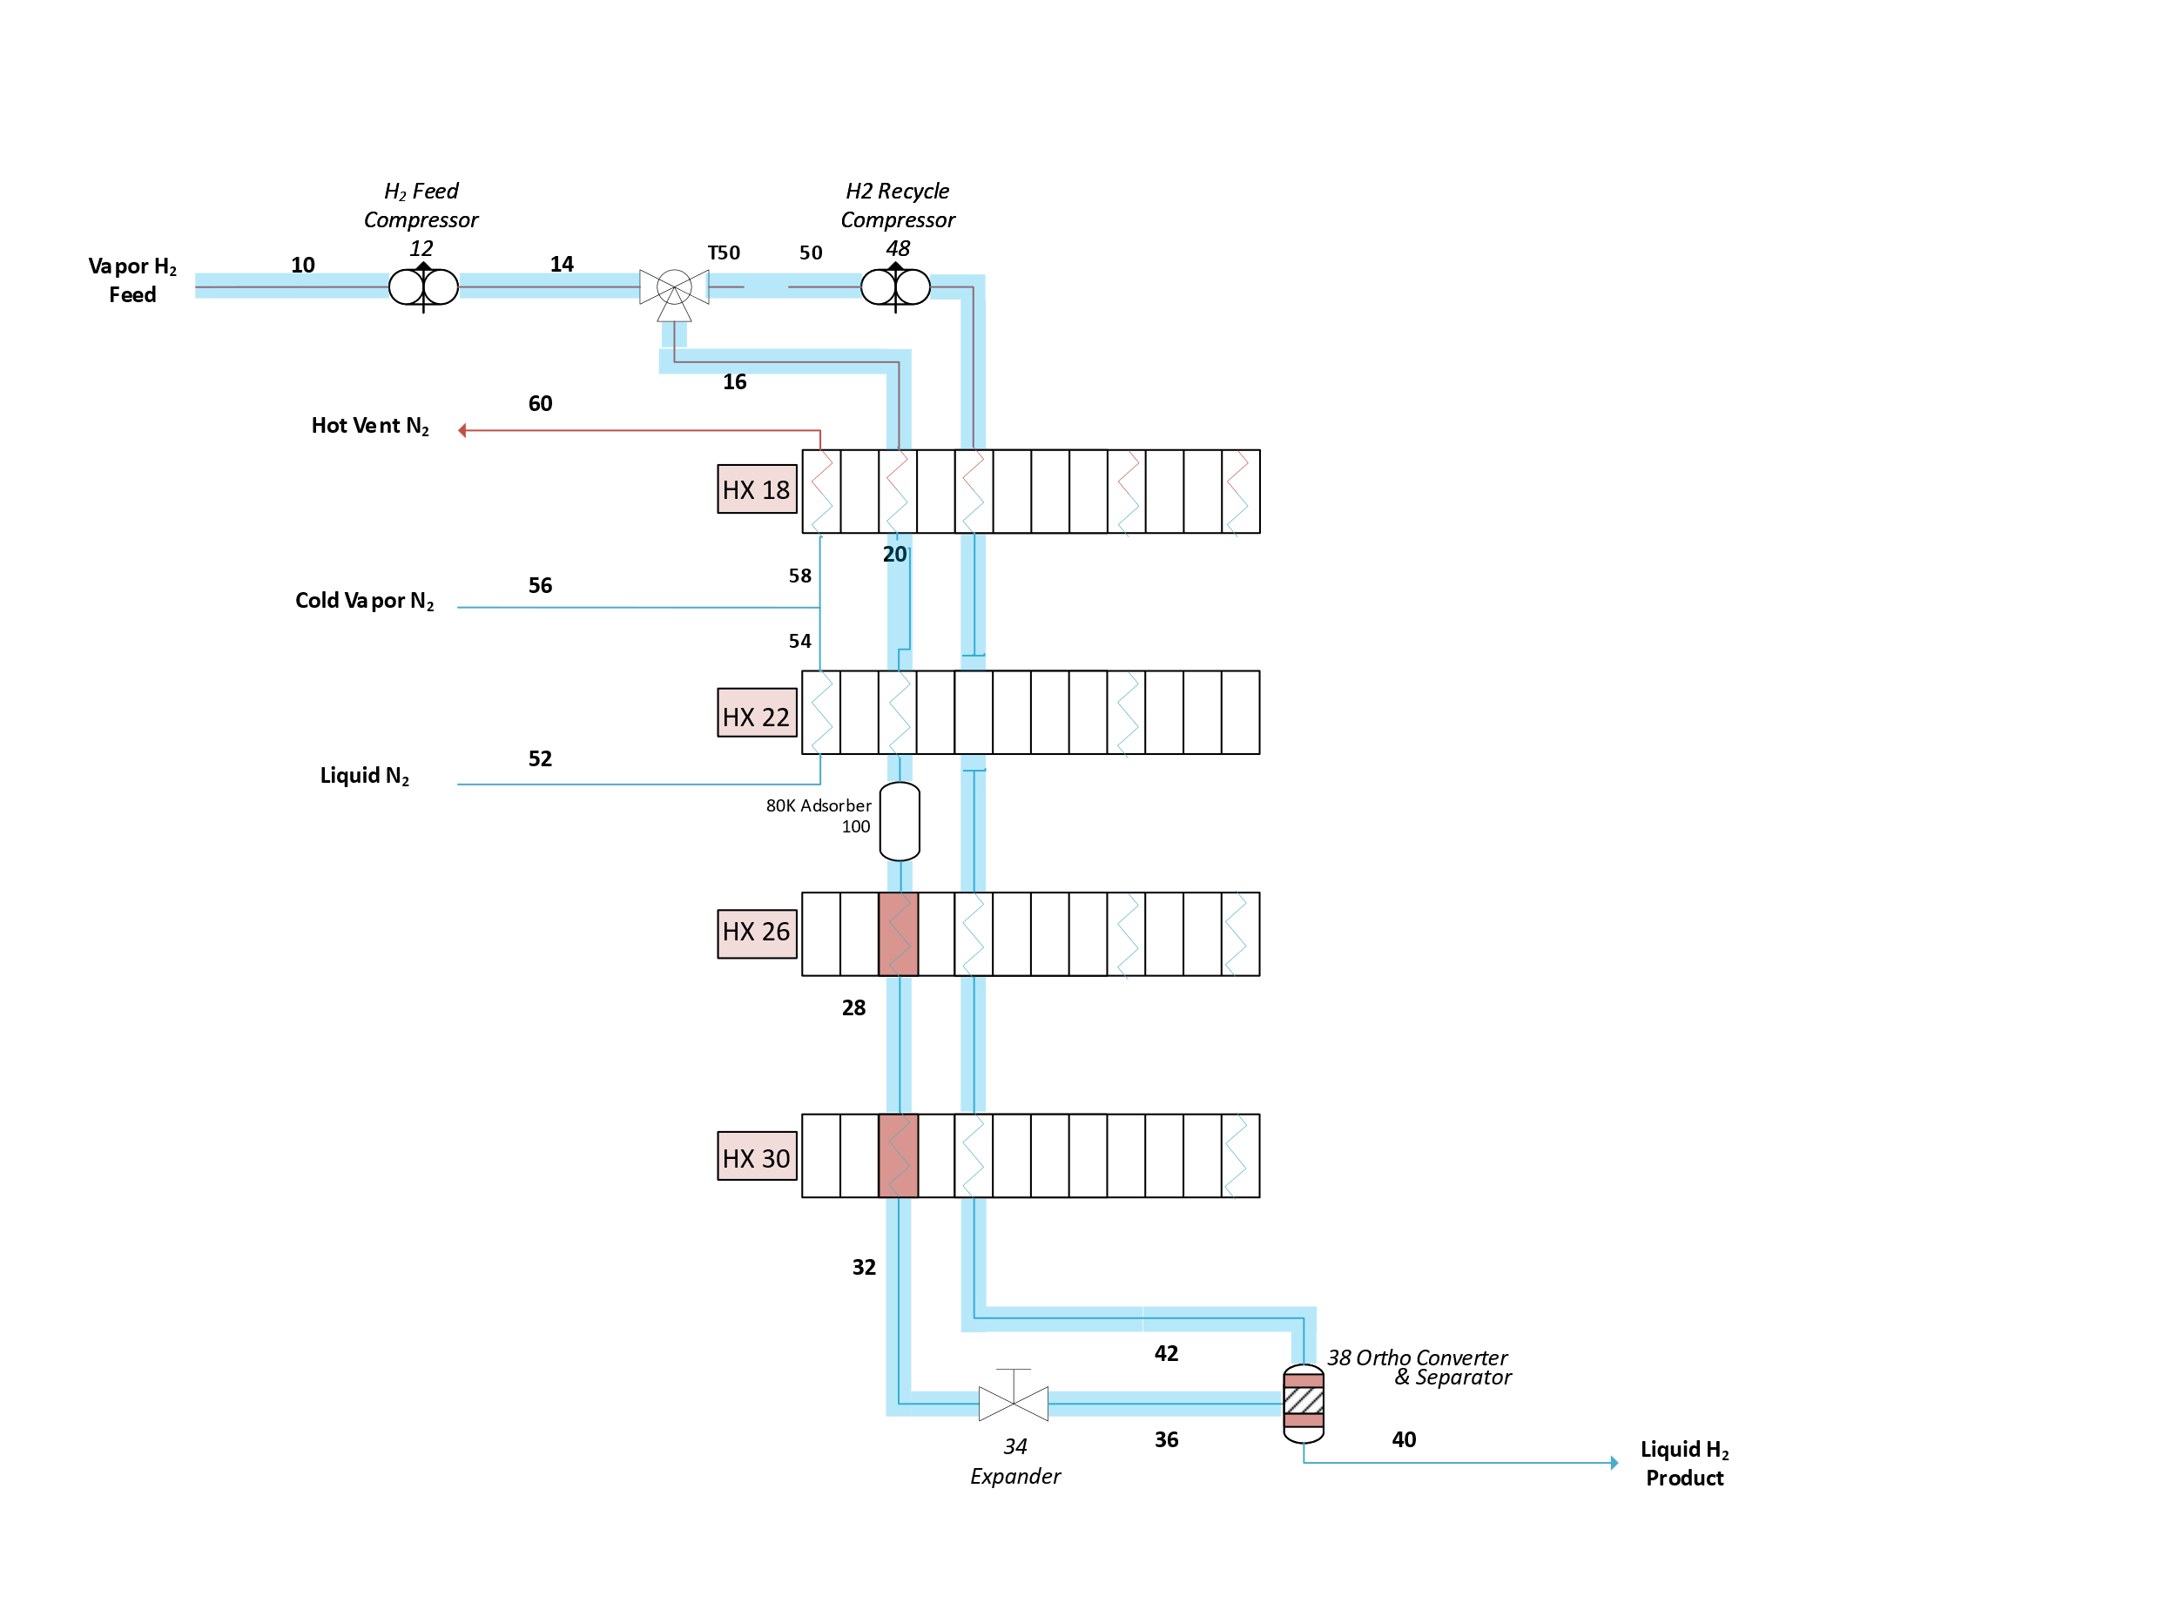
Hydrogen Refrigeration
Loop
Ortho – Para Reaction
34 Dense Fluid Expander
Notes:
Evan -
In the hydrogen refrigeration loop, feed hydrogen enters the process at 100 degrees Fahrenheit and 265 psia.
The gas is precompressed to 650 psia before mixing with a recyle stream and passing through a series of 4 heat exchangers. In Heat Exchangers 18 and 22, hydrogen is cooled by liquid and saturated vapor nitrogen, bringing its temperature to -310 Farenheit. At this temperature, residual stream impurities such as carbon dioxide entrapped in feed water and oxygen not separated in electrolysis are adsorbed onto an activated carbon adsorption column. The now pure hydrogen stream is further cooled in heat exchangers 26 and 30 to -404 farenheit by a process refrigerant, neon, which we will discuss soon.
This pure hydrogen stream is comprised of 75% o-H2 spin isomer and 25% p-H2 spin isomer. As this mixture passes through exchangers 26 and 30, ortho-hydrogen is reacted over hydrous ferric oxide catalyst to an end concentration of 95% para-hydrogen, 5% o-H2. Energy is then recovered from the high pressure, supercritical hydrogen stream using a dense fluid expander, creating a vapor liquid equilibrium at -414 F. The final ortho-para reaction is performed alongside phase separation in a catalytic phase separator, which is a knockout drum packed with catalyst. The vapor phase from this catalytic separator returns as a cold stream to the previous heat exchangers, and the liquid phase is taken as product.

Slide 22
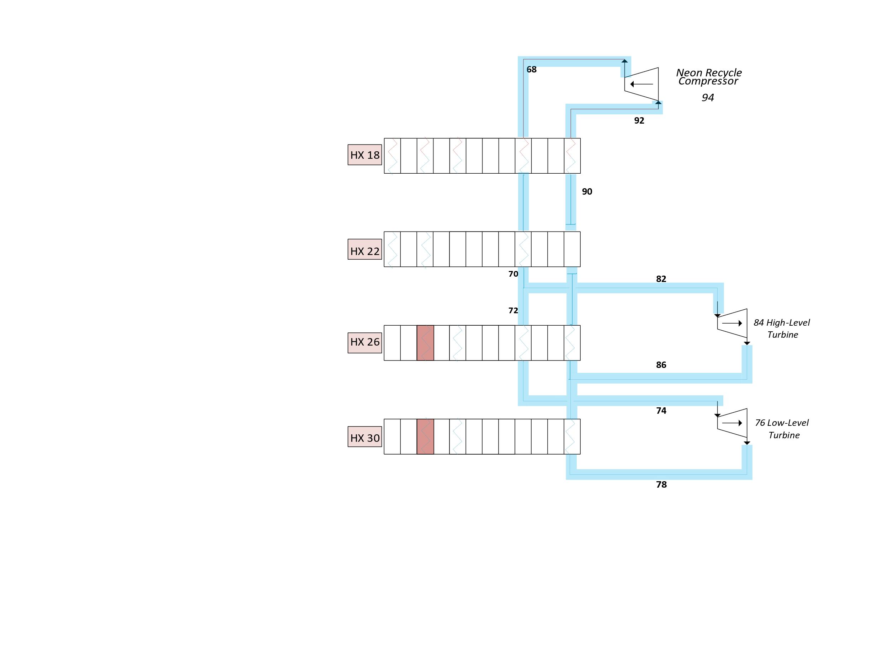
Neon
Refrigeration
Loop
84 High level Turboexpander
76 Low level Turboexpander
Notes:
Evan -
As previously mentioned, heat exchangers 26 and 30 require a neon refrigerant to reach temperatures below -310F (80K). These cryogenic temperatures are reached through a reverse brayton cycle, whereby neon is compressed, cooled by nitrogen in heat exchangers 18 and 22, and split into two streams that expand at different powers to provide cooling at different temperature intervals to heat exchangers 26 and 30.

Slide 23
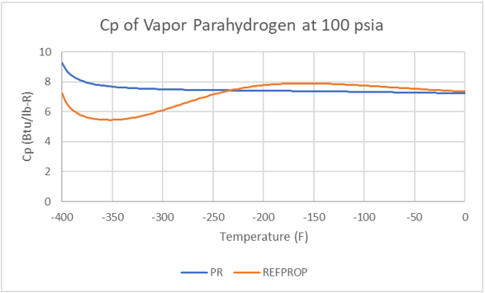
ASPEN PLUS lacks an accurate EOS that models cryogenic hydrogen
Initially, Peng-Robinson (PR) EOS selected
C_{p} of p-H₂ at high pressures, cryogenic temperatures up to 50% off
For this reason, REFPROP Databank (NIST) chosen
Notes:
Akash -
In our preliminary process design, the team selected the Peng-Robinson EOS to model cryogenic hydrogen. The Peng-Robinson EOS is primarily used in natural gas liquefaction processes, so the design team believed it was a logical choice of equation of state. However, upon comparison to NIST data on p-H2, the team discovered that the heat capacity of para hydrogen was up to 50% off at cryogenic temperatures.
This is important because the Cp/Cv ratio is important for equipment sizing

Slide 24
REFPROP Databank is not an Equation of State
Equation of State: A relationship between pressure, volume, and temperature for a substance or set of substances
REFPROP is not an EOS:
It performs linear interpolation between experimental values across multiple studies
Because REFPROP is a databank, it lacks mixing parameters
This is a problem because there are mixed ortho-para hydrogen streams throughout the process
It precludes the option of evaluating mixed refrigerants in this study.
Creative flowsheeting techniques used to model mixed o-H₂, p-H₂ streams are discussed
Notes:
Akash -
REFPROP is not an Equation of State. It is a databank, so it performs linear interpolation between recorded values. Because REFPROP is a databank, it lacks mixing parameters. This is a problem because there are mixed ortho-para hydrogen streams throughout the process. Creative flowsheeting techniques used to model mixed o-H2 and p-H2 streams are discussed next.

Slide 25
Use of REFPROP Databank requires creative flowsheeting: Tear Streams
Compressed Feed (S-16)
Actual | Feed Hydrogen | Before HX 26 | After HX 26 | After HX 30 | After DFE
o-H₂ | 75 % | 66 % | 36% | 5% | 1%
p-H₂ | 25 % | 34 % | 64% | 95% | 99%
HX 18
HX 22
Table 1: Actual o-H2 and p-H2 compositions for our process, calculated using a Packed Bed reactor model of Heat Exchanger passages
HX 26
Our approximation | Feed Hydrogen | Before HX 26 | After HX 26 | After HX 30 | After DFE
o-H₂ | 75 % | 75 % | 0% | 0% | 0%
p-H₂ | 25 % | 25 % | 100% | 100% | 100%
HX 30
Catalytic Phase Separator
38
Table 2: Tear stream o-H2 and p-H2 compositions
DFE
34
Product LH₂
100% n-H₂
100% p-H₂
Abridged version of process flow diagram
Notes:
Akash -
The reaction from o-H2 to p-H2 happens gradually, beginning in heat exchanger 26 when cryogenic temperatures are reached, through heat exchanger 30, up to the catalytic phase separator (block 38). Since REFPROP does not contain mixing parameters, the progression of this reaction cannot be modeled through the process using reactors. This is because using reactors would create mixed-species streams. The compressed feed (Stream 16) enters as 100% Normal hydrogen (which contains 75% ortho spin isomer and 25% para spin isomer). It then runs through Heat Exchangers 18 and 22, exiting at around 66% o-H2 and 34% p-H2. Our ASPEN model regards the hot hydrogen stream exiting heat exchanger 22 as 100% NH2 (which is again 75% ortho spin isomer and 25% para spin isomer). So far, this approximation is reasonable. This stream is taken out and a new tear stream that is 100% p-H2 is introduced going into HX 26. After HX 26, there is a significant deviation between our ASPEN model’s composition (100% p-H2) and the actual composition (36% o-H2 and 64% p-H2). After HX 30 and the dense fluid expander, ASPEN compositions essentially match actual compositions.
The tear stream model is selected because it is the only way to take advantage of REFPROP’s accurate physical data on cryogenic hydrogen.

Slide 26
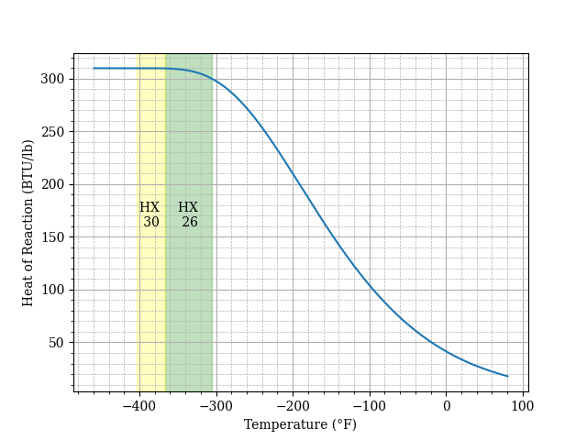
Use of REFPROP Databank requires creative flowsheeting: Calculator Blocks
Compressed Feed (S-16)
$$H_{Rxn,avg} = \frac{1}{T_{out}−T_{in}}×\int_{T_{in}}^{T_{out}}{H_{Rxn}(T)}$$
HX 18
$$Q_{leak}=\left(ΔOH_{2}\right)×H_{Rxn,avg}$$
HX 22
Calculator Block 1: HX 26, (Heat Leak 1)
HX 26
Calculator Block 2: HX 30, (Heat Leak 2)
Actual | Before HX 26 | After HX 26 | After HX 30
o-H₂ | 66 % | 36% | 5%
p-H₂ | 34 % | 64% | 95%
HX 30
Catalytic Phase Separator
38
DFE
34
Table 1: Actual o-H2 and p-H2 compositions for our process, calculated using a Packed Bed reactor model of Heat Exchanger passages
Product LH₂
100% n-H₂
100% p-H₂
Abridged version of process flow diagram
Notes:
Akash -
The reaction from o-H2 to p-H2 happens gradually, beginning in heat exchanger 26 when cryogenic temperatures are reached, through heat exchanger 30, up to the catalytic phase separator (block 38). The reaction from o-H2 to p-H2 is exothermic, with a heat of reaction according to the curve shown. The heat released from the reaction of o-H2 to p-H2 is modeled as a heat leak in HXs 26 and 30 using two separate Calculator blocks. This is calculated by multiplying the actual change in o-H2, shown in Table 1, by the average heat of reaction over the temperature ranges of HX 26 and 30.

Slide 27
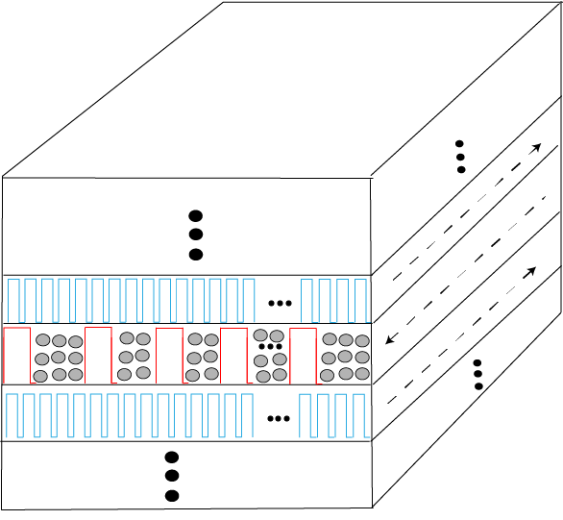
Modeled PBR conversions match assumed conversions
Heat Exchanger 26
Layer of Heat Exchanger 26 with Catalyst-Packed Passages
Modeled Distribution
Grey spaces: unaccounted area
Red: Fin
Actual Distribution
Red: Fin
Notes:
Evan -
Short Version, If Time Is Not Allowed: To validate the previously described assumptions and guide exchanger sizing, a detailed Packed Bed Reactor model was produced for both heat exchangers 26 and 30 using publicly available catalyst specifications and first order reaction kinetics, showing exit compositions of 65 and 97% para hydrogen, respectively. Heat exchanger 26 exhibits a high conversion and heat load within the first foot of its length, requiring an adjacent heat sink for even temperature distribution. Heat exchanger 30's composition change remains relatively linear across the length of the exchanger, showing the heat leak assumption discussed before as a viable solution to our modeling difficulties.
Detailed Version, I Would Prefer To Do: Heat exchanger 26 is modeled as having an entering concentration equal to that of the process feed, 25% para hydrogen, and exit concentration of roughly 65% para hydrogen. The red curve demonstrates the model when assuming a circular area for each space between fins, to align better with the PBR model. The blue curve represents the total cross-sectional area caused by passage fin geometry, here assumed to be sinusoidal. Fluid flow patterns along this complex geometry are not considered due to the small passage size and turbulent flow regime. Between the two curves, conversion change across the exchanger length is nearly identical. An important phenomenon to observe in this graph is the inlet concentration at Heat Exchanger 26. Here, feed hydrogen enters at approximately normal hydrogen composition, and due to a large gap between actual and equilibrium composition, reacts at a faster rate than any subsequent length increment of the exchanger. In reality, such a fast reaction would lead to a large heat release in this section of the heat exchanger that our model does not directly account for. Without any heat removal, this section would result in temperature rising by approximately 10 degrees. However, adjacent cold streams are designed to absorb the total heat of reaction across their length of the reactor. This section may decrease the exchanger efficiency marginally, and could be resolved by the addition of a cold sink at this section of the exchanger, but overall exchanger sizing and performance is not expected to change significantly. Another resolution to this complication that may be worth future investigation is the packing of catalyst at the end of Exchanger 22.
Heat exchanger 30 on the other hand, with an entering feed composition closer to the equilibrium hydrogen composition at its entering temperature, linearly distributes conversion across the length of the exchanger, thus linearly distributing heat in line with the Aspen model, with some tapering in reaction rate at the end of the reactor.

Slide 28
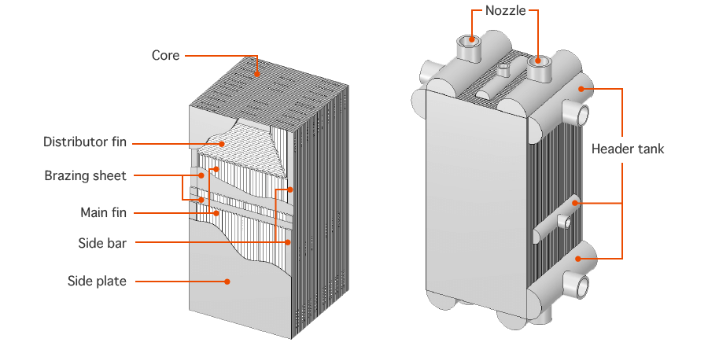
Brazed Aluminum Heat Exchangers (BAHX)
More compact, 20% size of alternatives and 95% lighter
Higher heat transfer, 10-20x more UA per volume
25-50% lower initial cost
Multiple streams: more flexibility in stream contact design
Reduced temperature approaches, as low as 2-3 °F (1-2 K) result in downstream power consumption reduction
https://files.chartindustries.com/Brazed-Aluminum-Heat-Exchangers.pdf
Notes:
Guille -
(Evan here, moved the old version of this slide to the very bottom of the slidedeck)
Script:
The core of the process is comprised of heat exchangers: units 18, 22, 26, and 30. You cannot make a refrigeration cycle without the medium that transfers heat from hot reservoirs to cold reservoirs.
In the case of cryogenic processes, the type of heat exchanger used is the brazed aluminum plate fin heat exchanger.
The brazed aluminum heat exchanger, or BAHX for short, provides several advantages to the shell and tube heat exchangers used in other process industries.
First of all, they are more compact, which increases the heat transfer efficiency and lowers cost.
Most importantly, they have the capability of taking in multiple streams and transferring heat between all of them simultaneously. This provides an enormous capital cost advantage over a network of two-stream shell and tube heat exchangers.
By taking in multiple streams and splitting them up into narrow passages, the brazed aluminum heat exchangers are able to transfer heat between streams that are as little as two to three degrees Fahrenheit apart. In cryogenic processes where the temperatures get very low, about 30 to 80 Kelvin, it is actually necessary for the temperature gradient between hot and cold streams to be this small in order to minimize lost work from irreversible entropic processes.

Slide 29
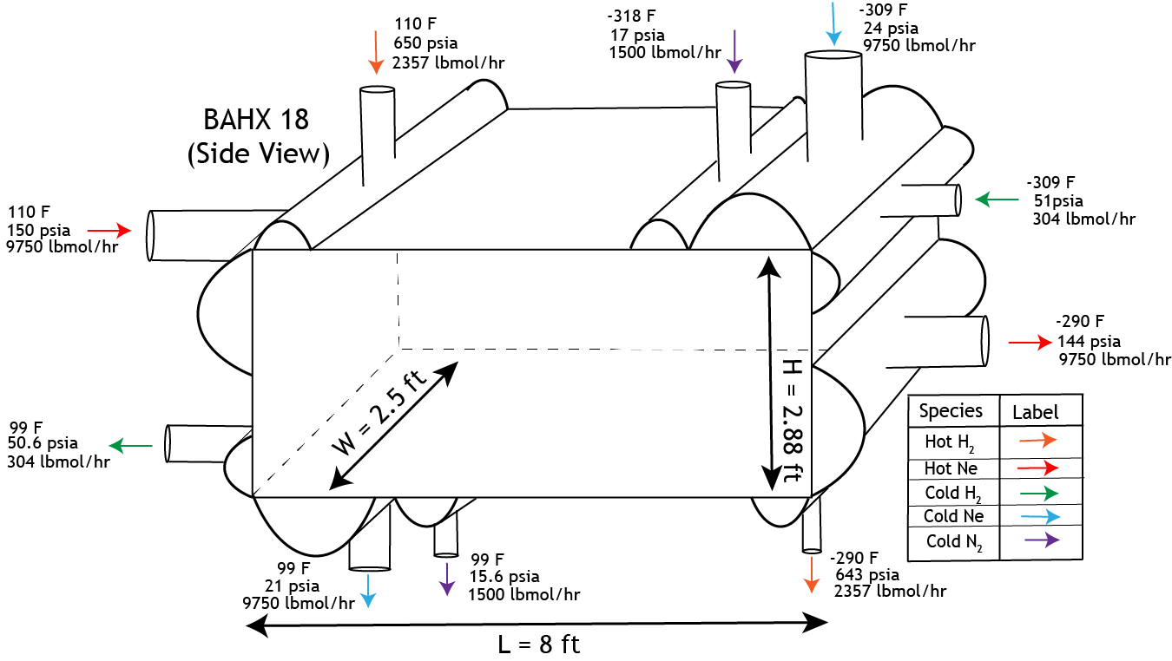
BAHX Design by hand: Heat Exchanger 18
Similar designs for HX 22, 26, and 30 in appendix slides
Notes:
Guille -
Script:
This figure shows the inlet and outlet streams to heat exchanger 18. The hot streams in orange and red flow oppositely to the cold streams in purple, blue, and green. Once the streams enter the heat exchanger they are distributed into a series of narrow passages (point out on slide).

Slide 30
$${∆T}_{min}$$
Notes:
Guille -
Script:
This is the composite curve for heat exchanger 18. This heat exchanger contains two hot streams spread out across 31 passages and three cold streams spread out across 76 passages. Both hot streams share the same temperature along the length of the exchanger, and so do all three cold streams.
This heat exchanger has a minimum approach temperature of ten degrees Fahrenheit, which occurs at the hot stream inlet in the upper right corner of this figure.
The deep cryogenic heat exchangers, 26 and 30, have minimum approach temperatures of two degrees Fahrenheit.

Slide 31
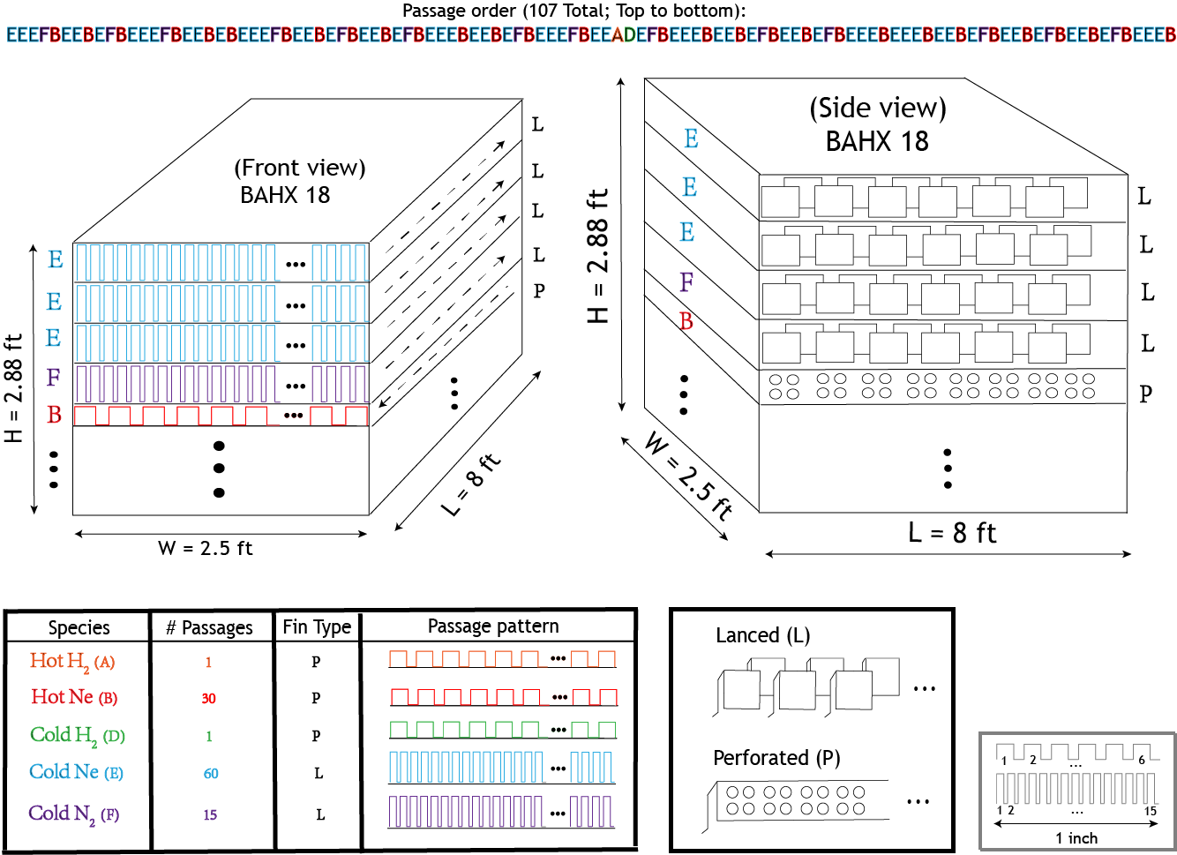
BAHX Design by hand: Heat Exchanger 18
Similar designs for HX 22, 26, and 30 in appendix slides
Notes:
Giulle -
what do we get from this that wasn't on slide 29
Script:
Here you can see how the passages inside the heat exchanger are distributed. Each of these passages are about 0.2 inches in height. In heat exchanger 18 there are 107 total passages, and the passages are arranged in an alternating pattern of hot streams and cold streams that maximizes heat transfer efficiency by making the temperature gradient along the heat exchanger as uniform as possible. Each passage is fitted with aluminum fins that augment heat transfer.
All of the detailed specifications of the heat exchanger, like its size, number of passages, types of fins, and the spacing of fins, were calculated according to an algorithmic method taught to us by Professor Leonard Fabiano.

Slide 32
BAHX design constrains process design
Notes:
Guille -
Script:
The brazed aluminum heat exchangers were designed according to an algorithmic method taught to us by Professor Leonard Fabiano. The details are not too important. The important detail to remember is that the pressure drop of streams along the length of the heat exchanger is informed by the heat exchanger design. Because of this, the design of the BAHX is not independent of the process model, modeled in ASPEN. The pressure drops that the BAHX design spits out have to match the pressure drops in the ASPEN model. The iterative algorithm shown here describes how to get the ASPEN model to converge with the BAHX design.
In practice the algorithm took three iterations to converge. The takeaway result was that there were certain limits to how small the pressure drops in the heat exchanger could be, which led to constraints on the upper limit of efficiency for the design process.
For example, if we could use pressure drops of zero in the ASPEN model we could achieve an efficiency

Slide 33
Process Economics
Background
Process Design
Economics
Conclusion
Q&A/Appendix
33

Slide 34
Working Fluid ROI Comparison
Return On Investment
Process Efficiency
45 MTD
45 MTD
Notes:
Akash -
Script:
We compared the profitability and energy efficiency metrics of our process design over different liquid hydrogen production rates, from fifteen to ninety metric tons per day. Additionally, we compared the metrics over these rates for three different working fluids: neon, helium, and hydrogen. Initially we wanted to analyze mixed refrigerants as well, but due to the limitations of our thermodynamic modeling that Akash discussed earlier, we unfortunately had to scrap this analysis.
For all three working fluids, we observed an economy of scale, in which the financial profitability of the plant generally increases with the amount of hydrogen production.
The efficiency is generally constant with the amount of hydrogen production. The hydrogen refrigerant is the most efficient refrigerant and helium is the least efficient.
This sensitivity analysis informed our final design choice of a forty five metric ton per day plant using neon refrigerant. The neon refrigerant was chosen because it resulted in the most profitable design. The production rate was selected because it provided a large ROI, but we did not select a larger production rate with a larger ROI because the largest liquefaction plant in the world does thirty metric tons per day, and we did not want to risk overstepping this boundary.

Slide 35
Profitability Metrics
At a sales price of $13/kg LH₂ at -414 °F and 52 psia:
Total Installed Cost
$146.5 M
Total Permanent Investment
$231.7 M
Total Capital Investment
$262.6 M
Net Annual Earnings
$43.6 M
NPV in 2023
$44.4 M
Investor’s Rate of Return (IRR)
18.52%
ROI in Yr. 3 of Operations
16.57%
Notes:
Akash -
In summary ….. →

Slide 36
CAPITAL COST Breakdown
Total Capital Costs – Bare Module
Without Electrolyzers
*catalyst, working fluids costs not displayed due to small cost
Notes:
Akash or Evan – My name was listed here and there wasn't a title any script written here. Happy to hand this off if someone prefers doing it. I think Akash did slides like this in the SEAS challenge file?
As you can see, the electroylzer bare module cost represents over two thirds of the cost of equipment for the plant, which can only be reduced through innovation. The cryogenic process equipment cost, however, is driven primarily by compressors. Compressors costs may be reduced by further driving down approach temperatures, specificallly on exchanger 18. However, to do this would require a buffer in temperature difference between feed hydrogen and liquid nitrogen, possible by adding an additional exchanger before exchanger 18 with a warmer refrigerant.

Slide 37
OPERATING COSTS Breakdown
Annual Process Utility Costs
Annual Total Production Cost
*Could offset utility costs by $5.2 MM/year Pure O₂ Sales
Notes:
Evan – My name was listed here and there wasn't a title any script written here. Happy to hand this off if someone prefers doing it. I think Akash did slides like this in the SEAS challenge file?
Similar to the previous figures of capital costs, operating costs are driven primarily by electrolysis and compression. As process automation increases, other cost centers such as general expenses and maintenance may be reduced, but are not significant engineering considerations.

Slide 38
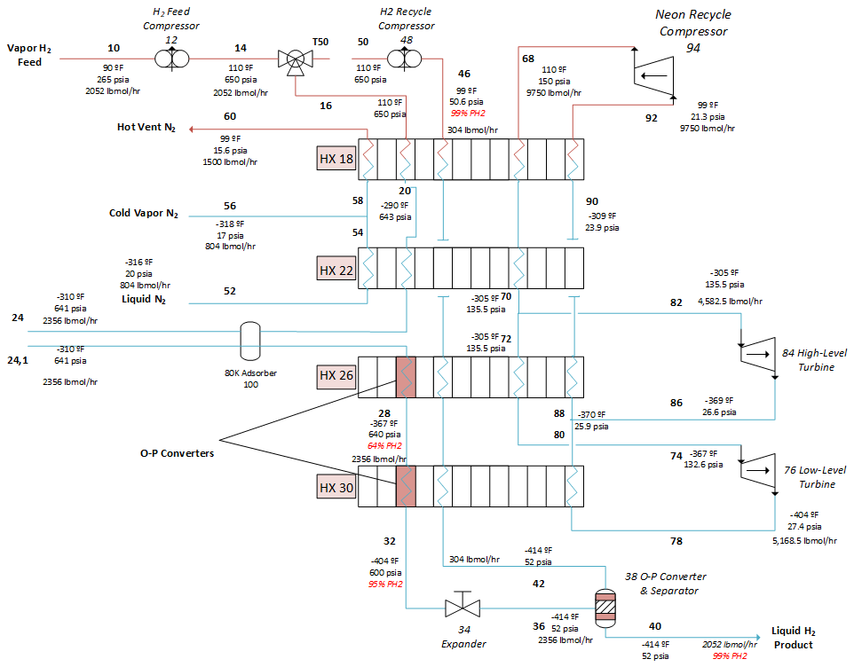
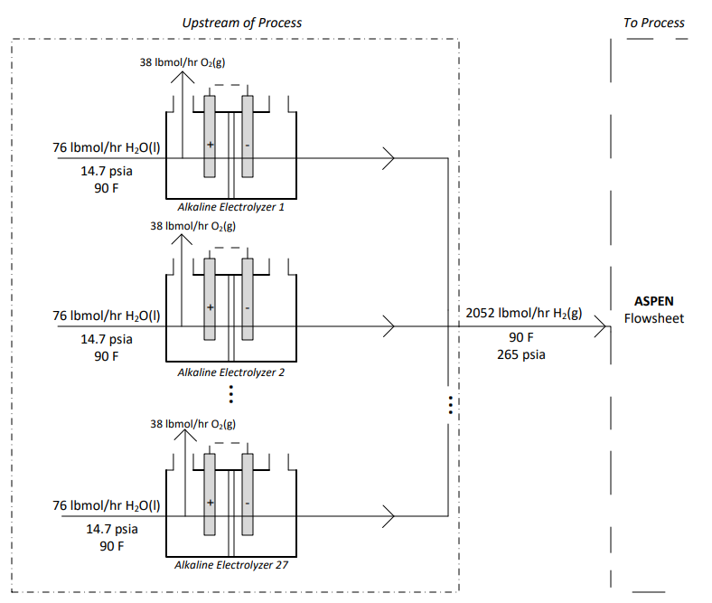
Sensitivities of Chosen Process Design to Financial Viability
3) Neon Recycle Compressor Power Requirement
1) Capital Cost and Efficiency of Electrolyzers
2) ∆T_{min}
Notes:
This process

Slide 39
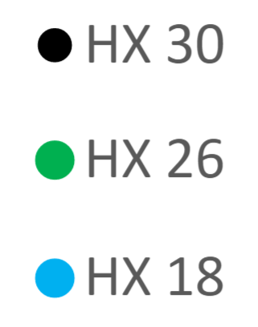
Heat Exchanger Approach Temperatures
upper limit
46.4
*results gathered by varying
Notes:
Guille or Akash? I forget
Slides 38 and 39 are two jewels of this presentation. Let’s make sure this is communicated clearly.
We should probably explain how energy efficiency and ROI are both calculated before this slide. So after slide 46. Also what the fuck a minimum approach temperature is lol (best to talk about this in slides 27-31; actually, including a composite curve may be the best way to do this).
Script:
We completed a sensitivity analysis on the effect of the heat exchanger approach temperatures on the energy efficiency and on the return on investment in the third year of plant operation.
The chart on the left shows that the efficiency of the plant increases as the approach temperatures tighten. By tighten we mean that they get smaller. Any chemical engineer that has worked in cryogenics will know that this is an expected result. When the approach temperatures tighten, the outlet pressures of the neon streams coming out of the turboexpanders in the refrigeration loop increase. When the outlet pressures of the neon streams coming out of the turboexpanders in the refrigeration loop increase, the pressure of the neon stream that is compressed by the neon recycle compressor (94) increases. Since the outlet pressure of the neon recycle compressor (94) is fixed at 150 psi, if the inlet pressure increases, then the compressor has a smaller change in pressure, which means that the compressor has a smaller power requirement. By reducing the power requirement on the most energy intensive unit operation in the process, the efficiency increases.
It is interesting to note that the efficiency increases linearly with a decrease in the minimum approach temperature. Evidently, because the second law of thermodynamics stops us from having negative approach temperatures, there is an upper limit to the energy efficiency of this process design of about forty six to forty seven percent. For reference, the most energy efficient design in the literature has an efficiency of sixty seven percent, and most hydrogen liquefaction plants in operation today run at an efficiency of twenty to twenty seven percent.
The chart on the right shows that the return on investment in the third year of plant operation also increases as the approach temperatures tighten. Actually, it turns out that this is a noteworthy result. There is a tradeoff between the operating and the capital expenses of the plant that occurs. On one hand, the operating cost decreases as a result of the reduction in the power requirement. Also, the capital cost decreases because more powerful compressors are more expensive. On the other hand, the capital cost decreases because the heat exchanger gets larger when the approach temperatures decrease, and larger heat exchangers are more expensive. When there are contradictory effects like these, we expect to see a plot that is concave and has a maximum.

Slide 40
Return On Investment vs. Process Efficiency
Maximum ROI
Our Plant
Industry Operation
Notes:
Guille or Akash? I forget
In fact, if we combine these two graphs then we can see that indeed something of a maximum that occurs, just that it occurs at the very upper limit of efficiency. This occurs because the size of the heat exchanger blows up to infinity as the approach temperature goes to zero degrees Fahrenheit. In practice this never occurs because the approach temperatures in deep cryogenics are usually constrained to be above about two degrees Fahrenheit. So for these practical purposes, whether we optimize our process design for energy efficiency or for return on investment, we end up with the same design parameters.
#####
For most process designs of hydrogen liquefaction systems, this maximum occurs earlier and there is a decision that has to be made between optimizing for financial profitability and energy efficiency. In the real world, the MBAs have won and any hydrogen liquefaction plant operating today has an efficiency between twenty to twenty seven percent because that is the most financially profitable solution to the process design. We don’t know exactly what these processes look like, but most likely these plants are not operating at the upper limit of efficiency the way our process design is.

Slide 41
Conclusion & Recommendations
Background
Process Design
Economics
Conclusion
Q&A/Appendix
41

Slide 42
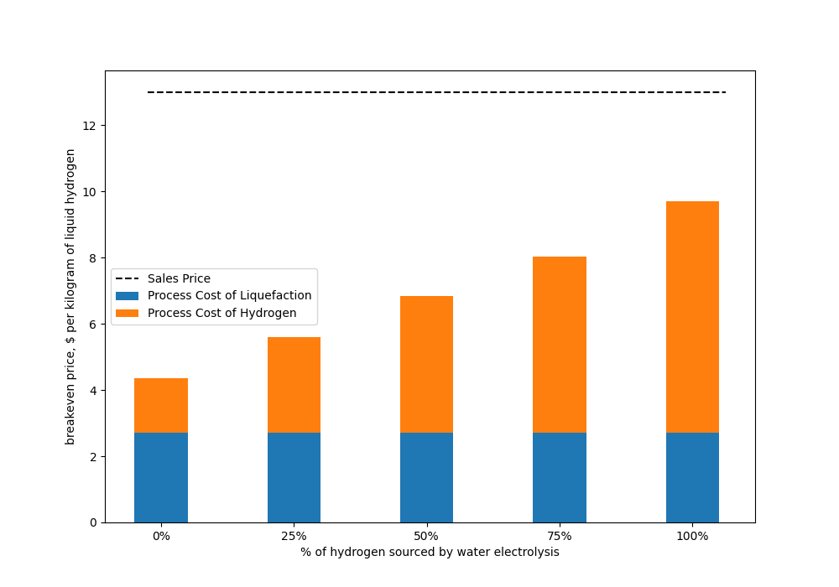
Breakeven Price ($/kg)
Electrolysis
0% | 25% | 50% | 75% | 100%
100% | 75% | 50% | 25% | 0%
SMR

Slide 43
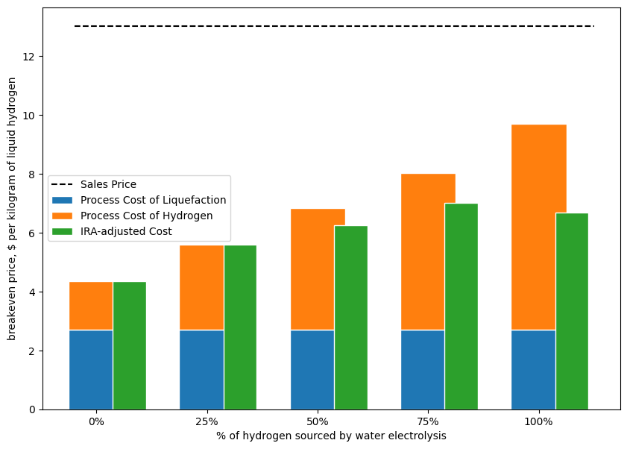
Breakeven Price ($/kg)
Electrolysis
0% | 25% | 50% | 75% | 100%
100% | 75% | 50% | 25% | 0%
SMR
Notes:
Evan:
We compared various scenarios that varied the source of the hydrogen feed to the liquefaction plant. At our planned operating conditions, one hundred percent of the hydrogen feed is sourced by way of water electrolysis. In this scenario, the breakeven price of green liquid hydrogen is nine dollars and sixty nine cents. The cost of liquefaction is two dollars and seventy one cents, so the cost of the green hydrogen feed comes out to six dollars and ninety eight cents, which is about what we expected to see.
If the price of wholesale renewable electricity where our plant is located were to drop ninety percent from ten cents per kilowatt hour to one cent per kilowatt hour, the breakeven price would be four dollars and ten cents, which would be cheaper than the current breakeven price for our plant operating at one hundred percent of the hydrogen feed sourced by way of steam methane reforming, four dollars and thirty five cents.

Slide 44
Competition with Fossil Fuels
Fuel Type | Price ($/million BTU)
Natural Gas Market Price (USA) | $2.22
Retail Electricity Price (USA) | $32.77
Retail Regular Gasoline Price (USA) | $31.95
Retail Hydrogen Price | $74.46 – $126.59
Grey Liquid Hydrogen Breakeven Price | $32.39
Green Liquid Hydrogen Breakeven Price | $68.51*
Green Liquid Hydrogen Sales Price | $96.80
April 22 2023 according to https://tradingeconomics.com/commodity/natural-gas
April 22 2023 national average according to https://gasprices.aaa.com/?state=PA (includes supply chain/infrastructure costs)
*Green Liquid Hydrogen Breakeven Price does not include supply chain costs
Notes:
$96.60 is the price we are selling at
Evan:
Script:
This table illustrates the competitive economics between liquid hydrogen fuel and other energy sources. The appropriate way to compare the unit economics of fuels is in terms of their dollars per energy; in this case we use dollars per million British thermal units, or BTU.
The thirteen dollar per kilogram sales price of the liquid hydrogen corresponds to a price of ninety six dollars and eighty cents per million BTU. This is forty four times more expensive than the price of the natural gas which is consumed by natural gas power plants that convert natural gas to electricity. This price is in line with the retail price of hydrogen vapor stored at seven hundred times atmospheric pressure, which you can find at hydrogen fueling stations in California. As of this moment nearly all the hydrogen at these fueling stations is grey, sourced by way of SMR. However this retail price is somewhat misleading because it includes the non-trivial costs of the hydrogen supply chain--that is, the cost of getting hydrogen from the plant to the station. This can add between fifty and eighty dollars per million BTU.

Slide 45
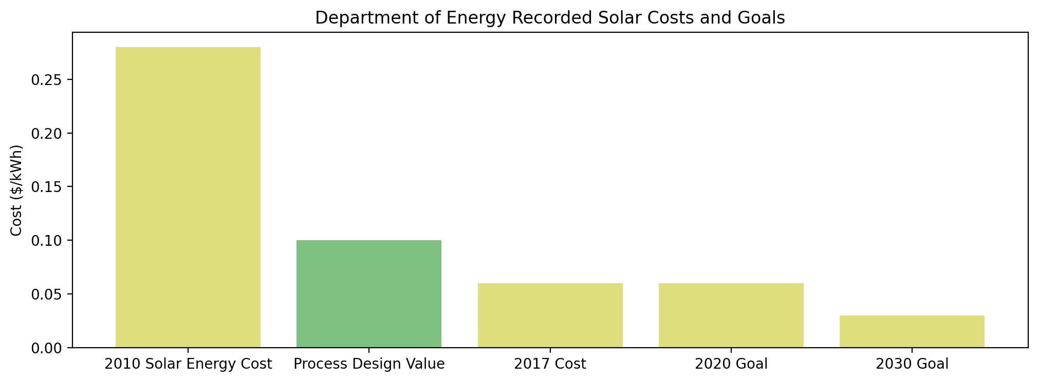
$0.10/kWh
Not Yet Integrated
DOE "SunShot"
Notes:
Evan
Another Department of Energy projection, like the $1/kilogram of Liquid Hydrogen by 2030 goal, is to have the cost of gridded solar green energy reduced to $0.03 per killowatt hour by 2030. Since our plant will be operating well past that deadline, it is important to consider the breakeven price implications of a shrinking electricity cost. While the chosen price of green electricity was set to $0.10 for profitability measures as a conservative estimate, the following sensitivity analysis is shown as a range of possibilities depending on how close grid improvements get to the DOE goal.

Slide 46
Sensitivity to Dropping Green Electricity Costs
*Current Breakeven Price
*Value once DOE 2030 Target is Reached
Notes:
As you can see in this graph to the left, beyond incremental improvements to unit operation efficiencies and production costs, the principle target area for cost reduction will come from the reduction of green electricity costing the years to come. If the DOE target is reached, the breakeven price of this process will reduce to under $5.50/kg, nearly halving the current price.

Slide 47
Future Research Areas: Electrolysis
Electrolyzers are a significant focus area for cost reduction in this process
Increase in Electrolyzer Efficiency
Decrease in Electrolyzer Cost
Current Green $/kWh ($0.10)
Current Green $/kWh ($0.10)
Current Grid $/kWh ($0.07)
Current Grid $/kWh ($0.07)
DOE Goal $/kWh ($0.03)
DOE Goal $/kWh ($0.03)
Notes:
Moreover, when focusing research towards process improvement and further cost reduction in the future, it is clear from this presentation that a major cost driver is the electrolysis of water, both operationally and in capital expenses. Here you can see the effect of innovation-driven cost reductions in the production of hydrogen. Recent literature has suggested methods of increases electrolyzer efficiency to as high as 95% and of decreasing bare module costs by as much as 50%. Should these options prove viable and scalable in the near future, such process improvements would drastically improve the product viability of hydrogen liquefaction in the process proposed.

Slide 48
Questions/Appendix
Background
Process Design
Economics
Conclusion
Q&A/Appendix
48
Notes:
With that, we've discussed the major considerations we've been able to fit into the length of this presentation. We greatly appreciate your engagement and welcome any questions you may have.

Slide 49
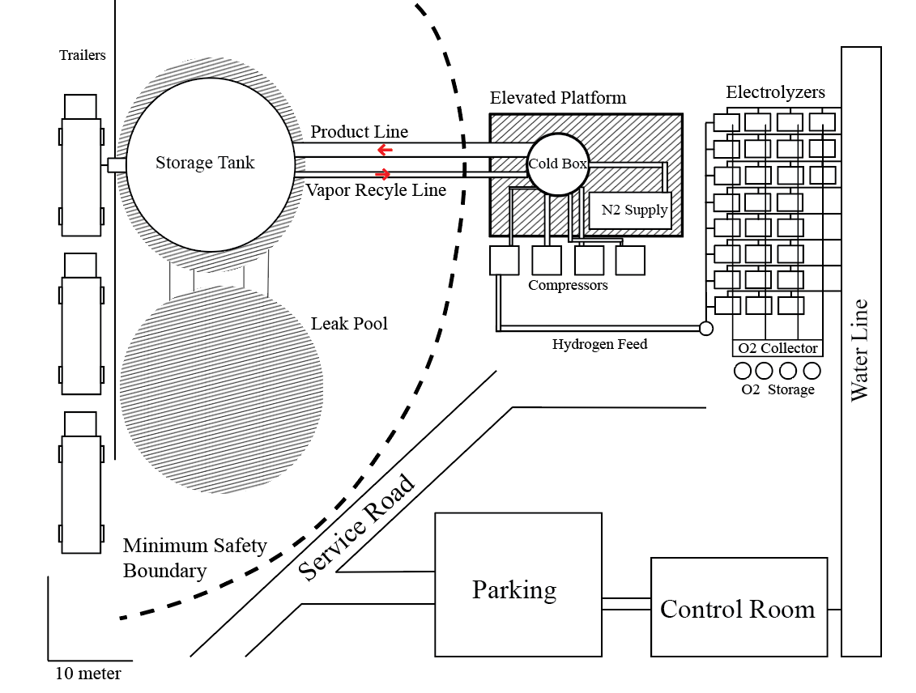
Questions?

Slide 50
Appendix Slides

Slide 51
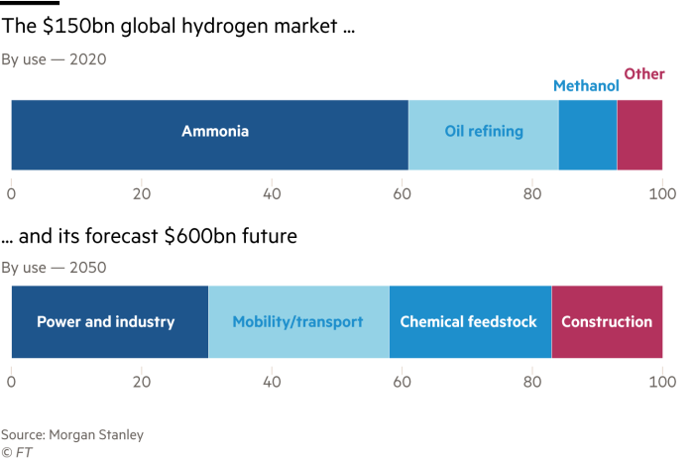
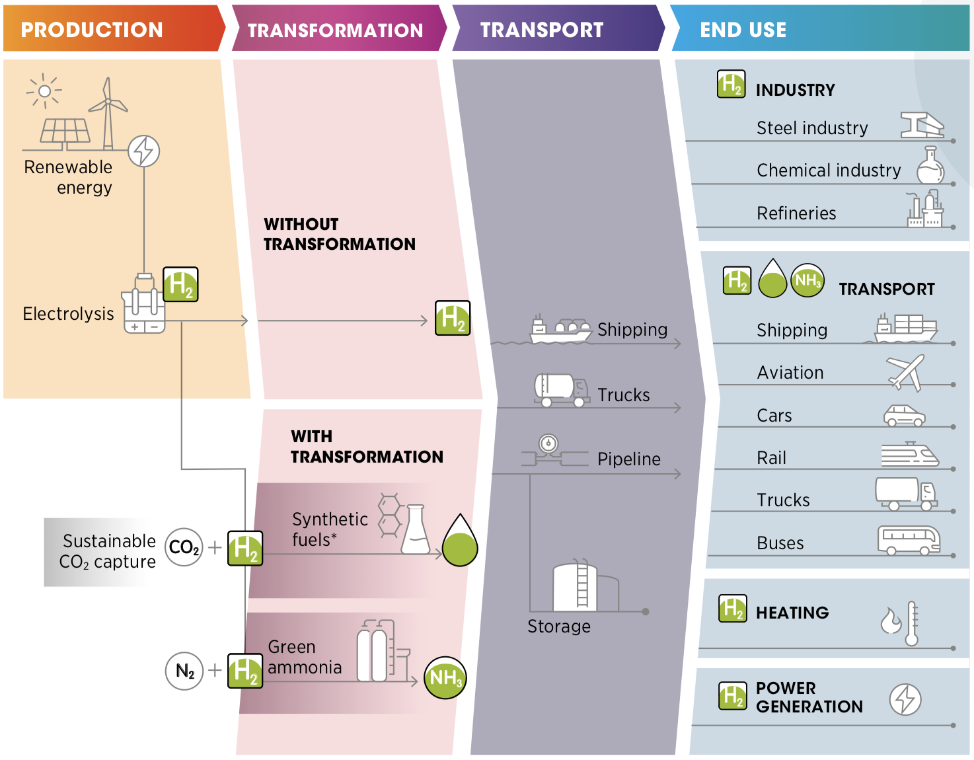
Hydrogen Value Chain
51
Notes:
Most of hydrogen is formed by steam methane reforming and used in chemical industry. The future: water-based hydrogen used as a fuel for mobility and power generation.
delete this slide. replace with explanation of liquid hydrogen need

Slide 52
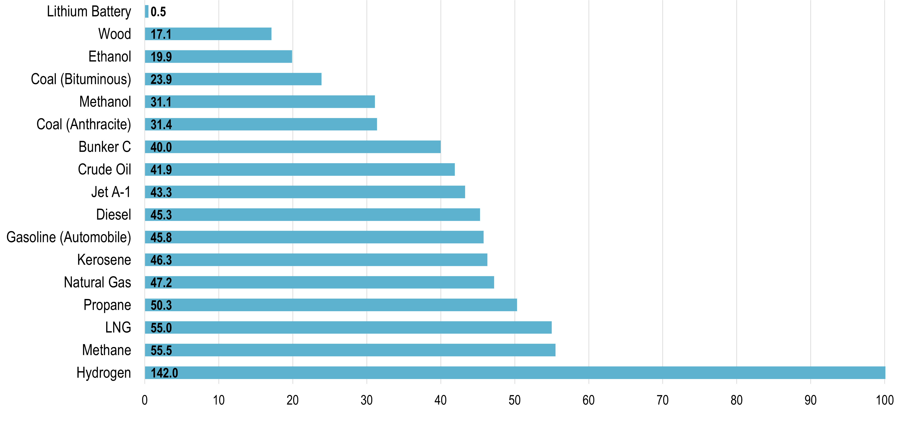
Hydrogen is the only Carbon Neutral Fuel
Renewable Energy Storage Vectors
*Non-carbon-
emitting
https://transportgeography.org/contents/chapter4/transportation-and-energy/combustibles-energy-content/#:~:text=The%20highest%20energy%20density%20fuel,or%20wood%20(three%20times).
Notes:
‘unique differentiation’
hydrogen has no carbon

Slide 53
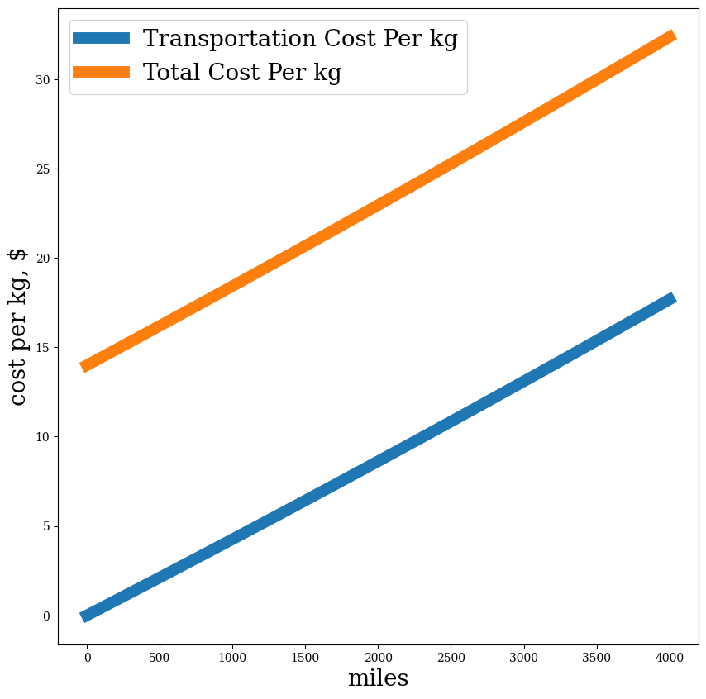
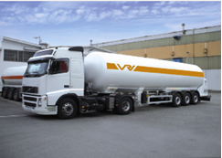
Cryogenic Transportation is Expensive
Assumes Chart 67,000 L Transportation Vehicles
Accounts for:
Evaporative Losses
Fuel Costs
Transporter Wages
Time Constraints per National Regulation
Round-Trip Costs
Vehicle Servicing
Could be reduced through rail travel, but scale of available infrastructure unknown
Notes:
Evan or Guille?
As you can see here, the transportation of liquid hydrogen is incredibly expensive operationally. Using cryogenic tankers that slowly boil off and vent contents as they absorb heat from their surroundings, transportation costs can be quite low for local travel within hundreds of miles, but scale linearly for interstate to transnational travel. These supply chain costs could be mitigated with an increasing number of well-distributed plants and a well-managed supply chain system.

Slide 54
Plant Location
Notes:
Evan or Guille?
We’ve chosen this region for our plant because it has a large density of high-usage consumers (rocket launch centers and airports) relatively low costs for green electricity, and relaxed plant production regulation.

Slide 55
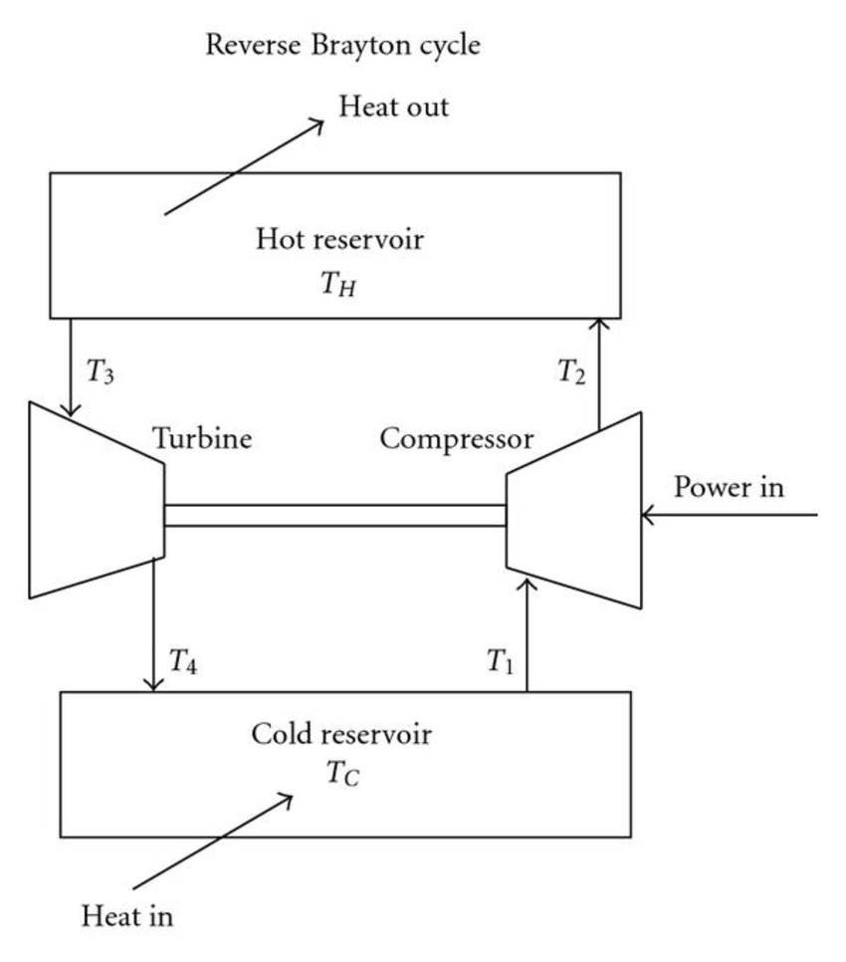
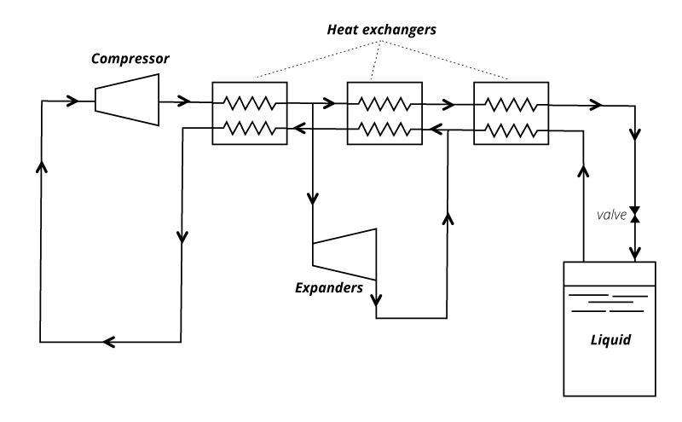
Schematic of a Claude Cycle
Schematic of a Reverse Brayton Cycle

Slide 56
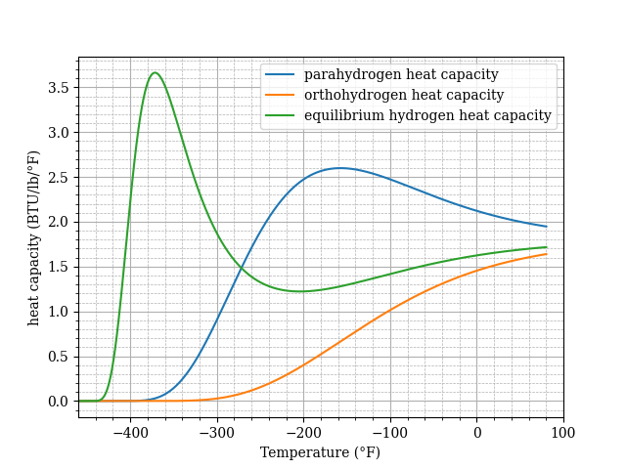
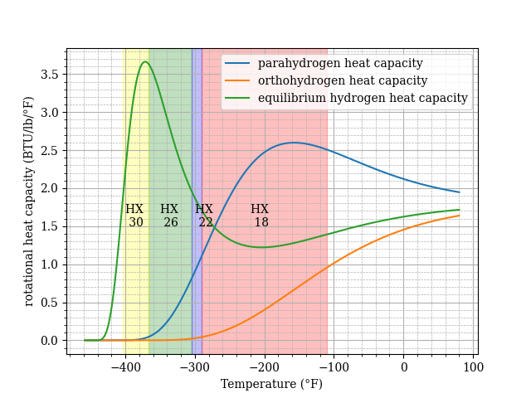

Slide 57
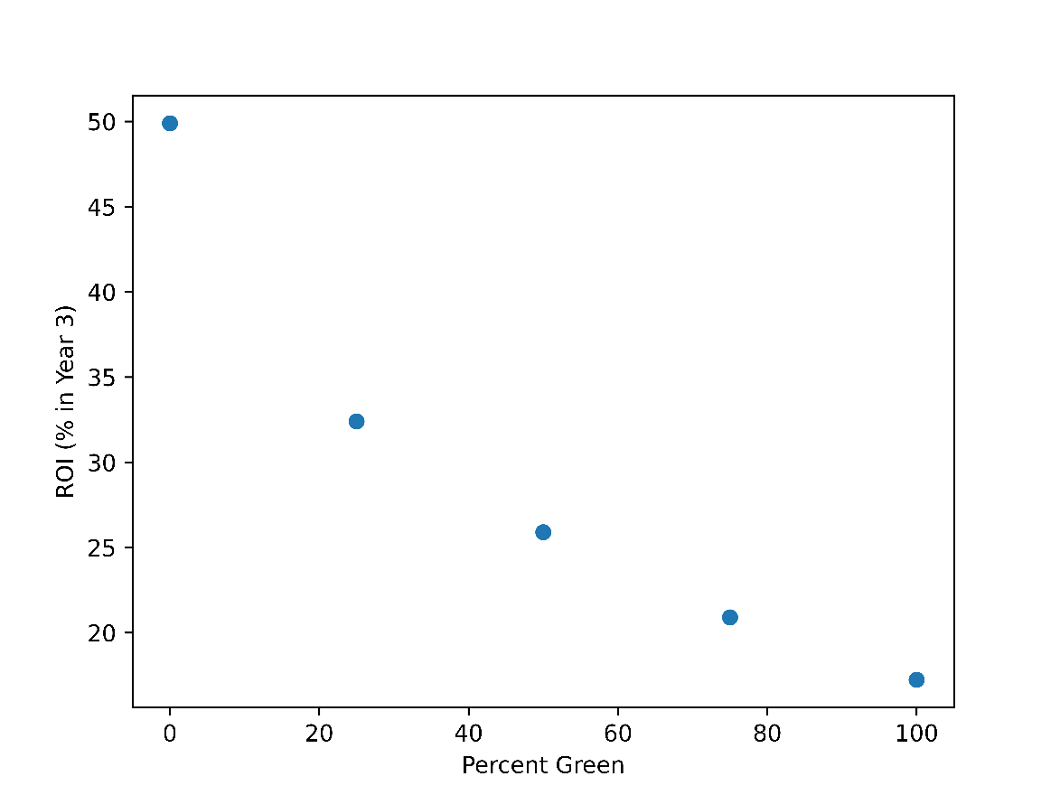
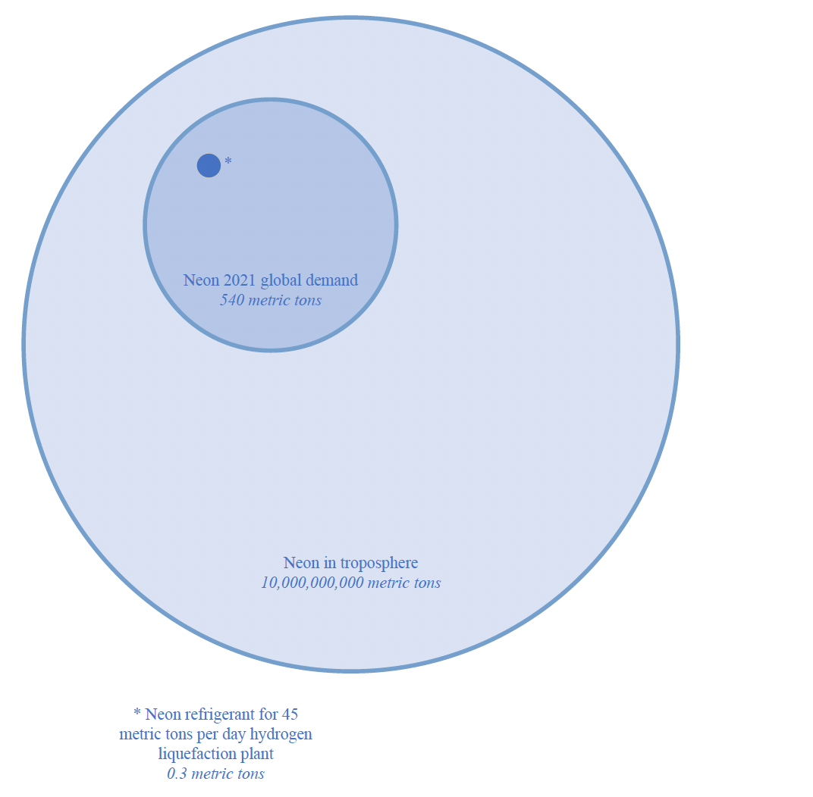
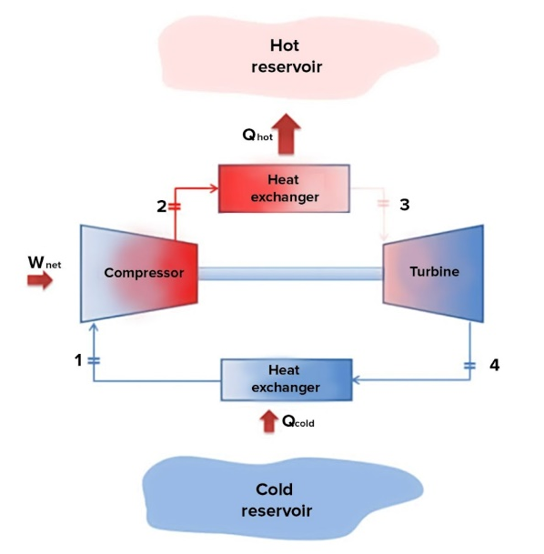
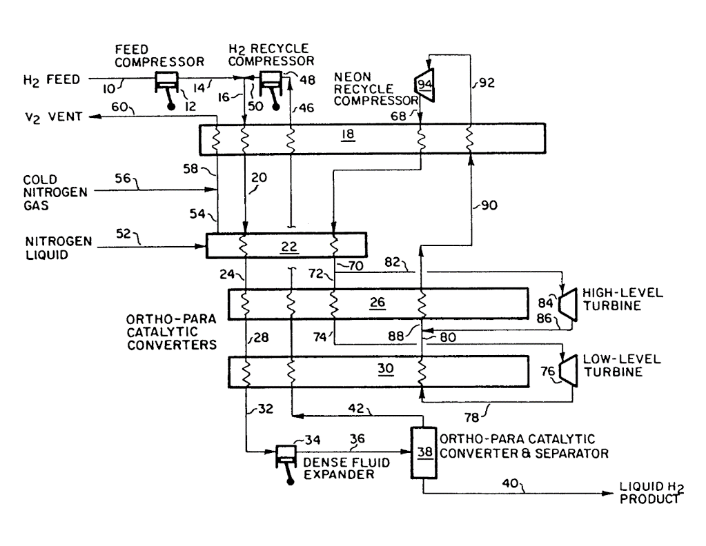
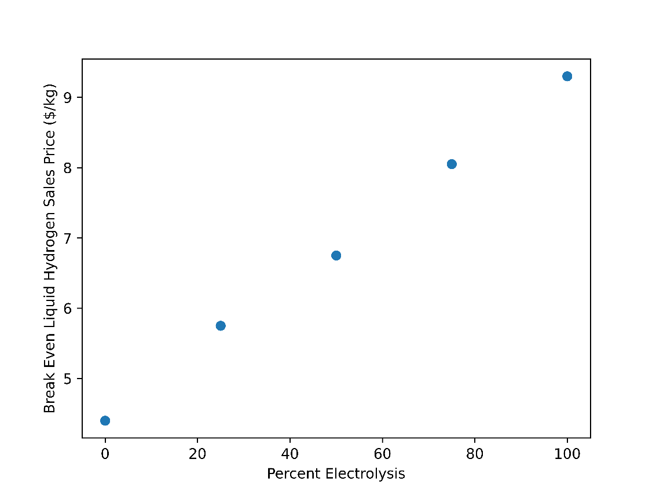
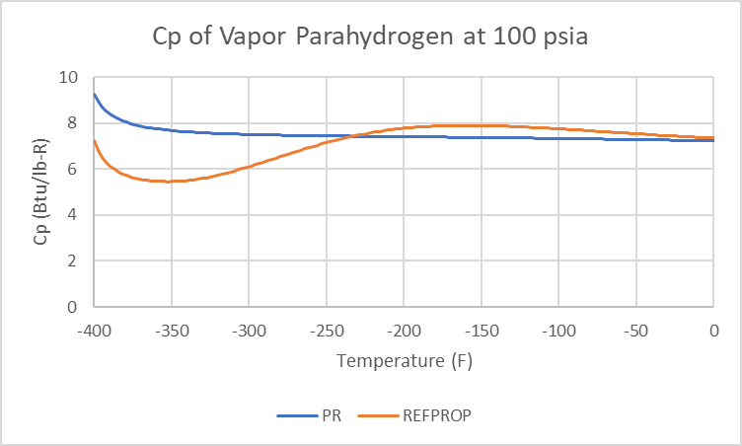

Slide 58
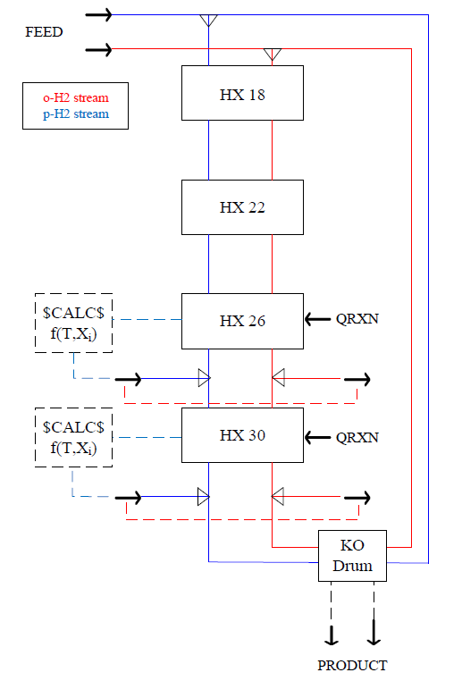
Raw Material | Unit Cost (USD/1000 gal)
Process water | $0.80
Refrigerant | Unit Cost (USD/lb)
Neon | $1600
Helium | $23
Hydrogen | ~$5
Nitrogen | $0.023
Catalyst | Unit Cost (USD/lb)
IONEX (Fe2O3) | $9
Ni-MOF-74 | $2960

Slide 60
Hydrogen Pipelines
1600 miles currently operating in USA, concentrated in Gulf Coast region for consumers in petroleum refining
Transports gas, not liquid
Problems with hydrogen leakage and embrittlement
Can be solved by mixing with natural gas and separating when needed (15:85)

Slide 61
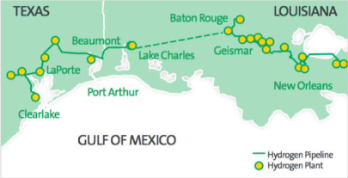

Slide 62
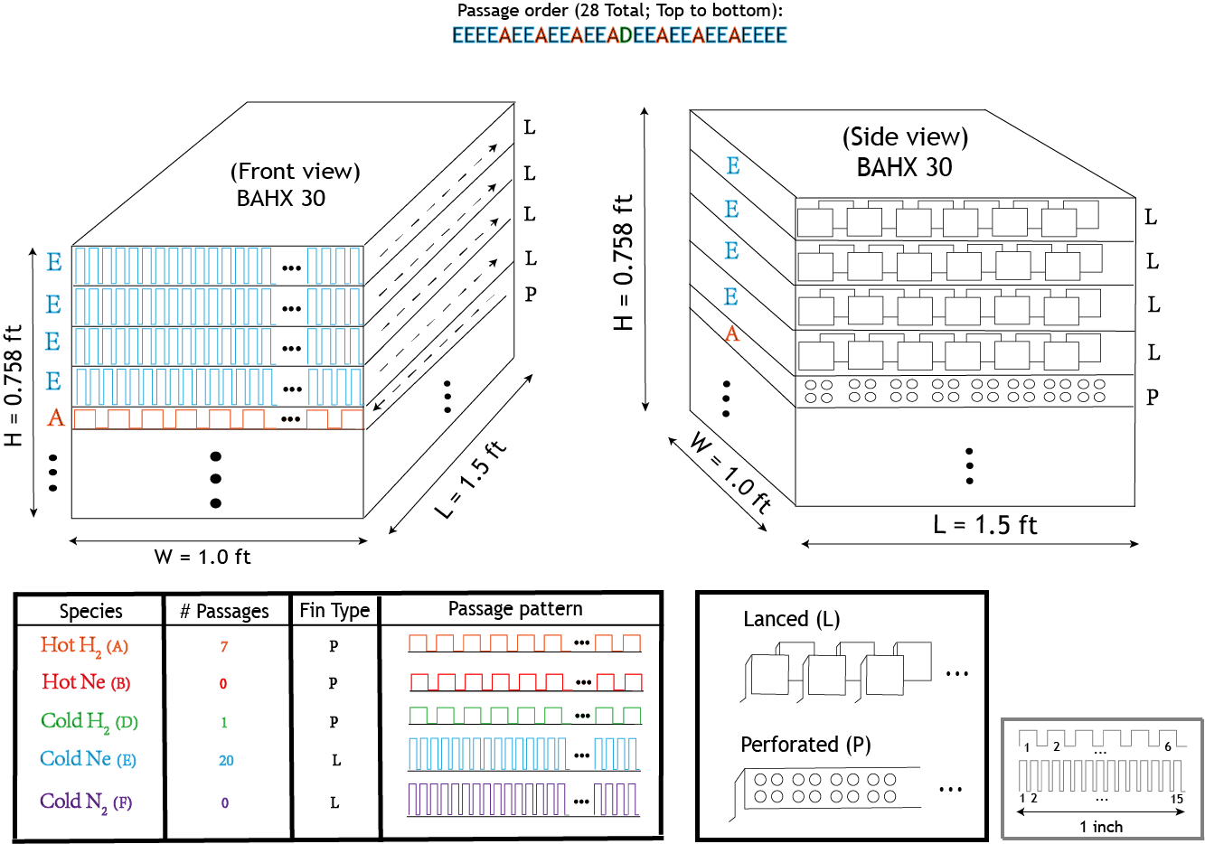
BAHX Design by hand: Heat Exchanger 30

Slide 63
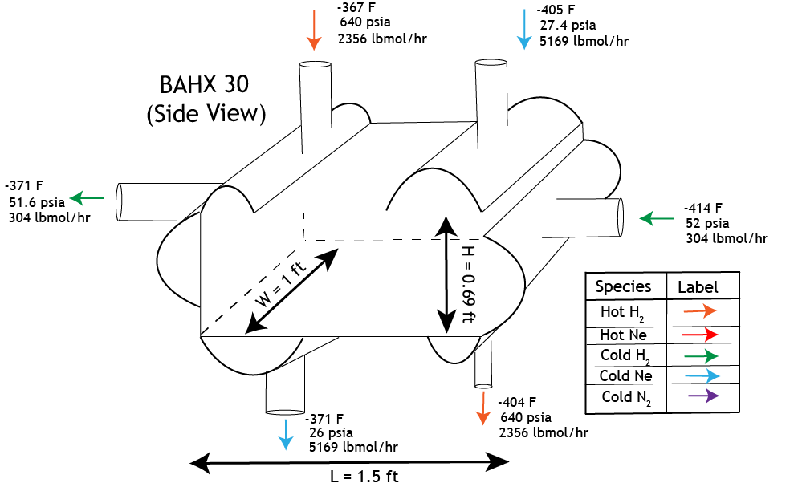
BAHX Design by hand: Heat Exchanger 30

Slide 64
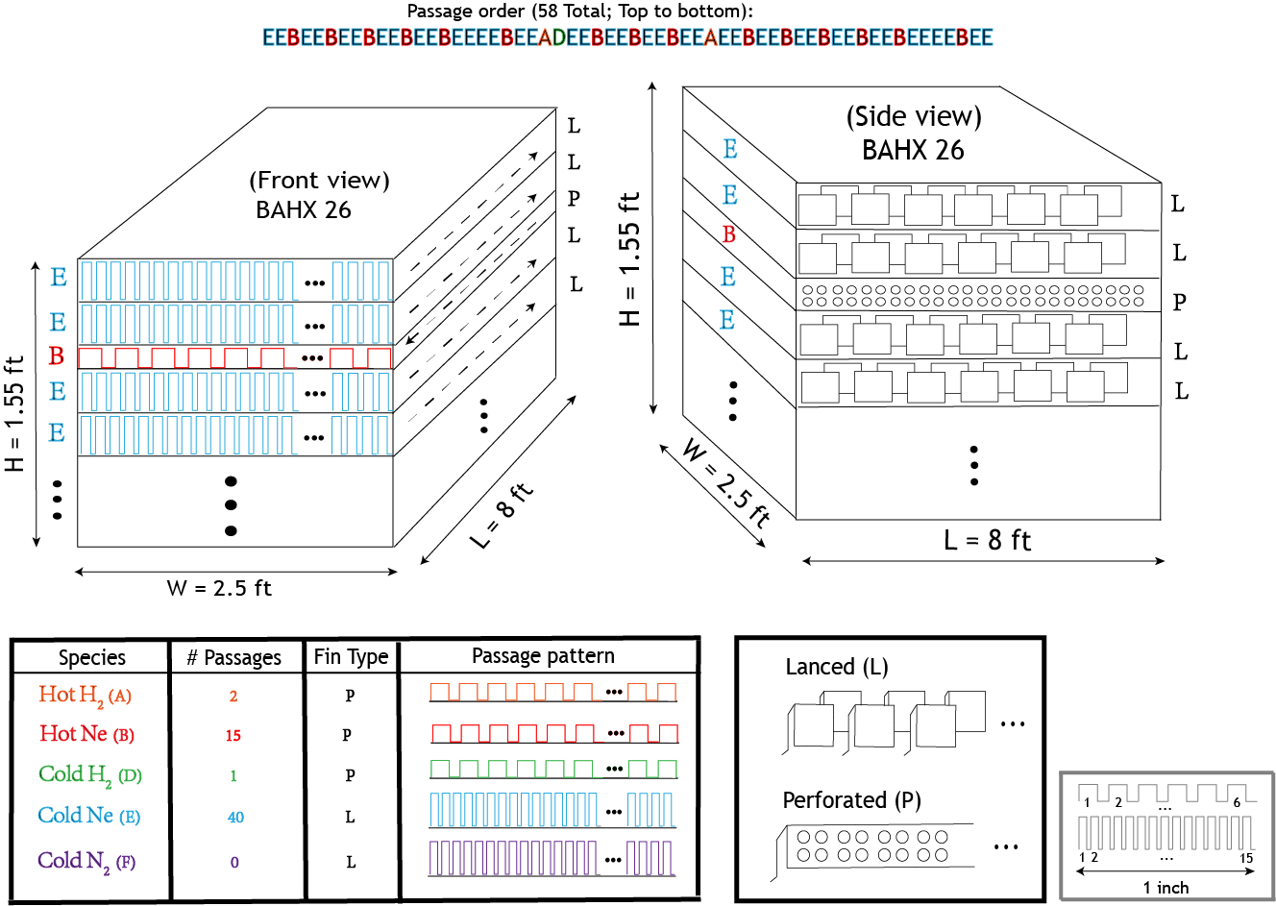
BAHX Design by hand: Heat Exchanger 26

Slide 65
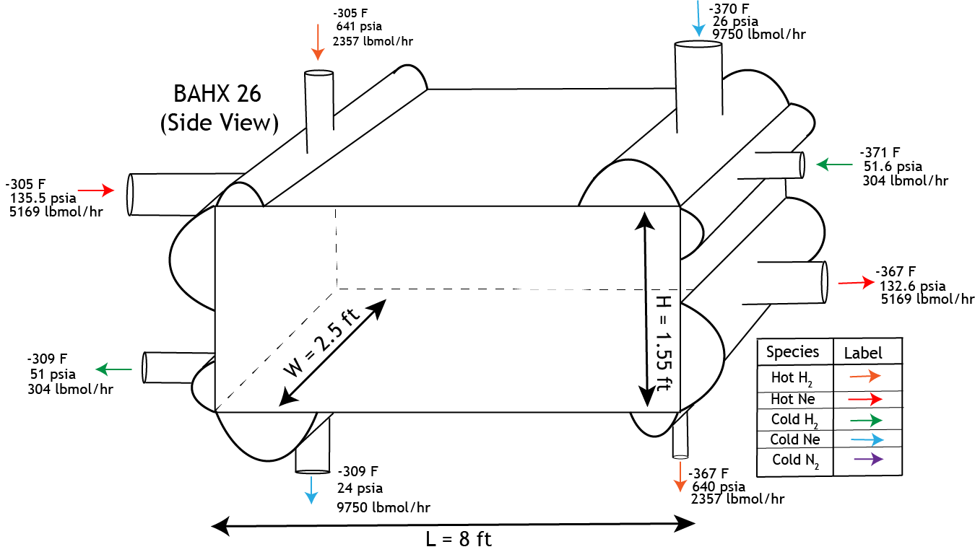
BAHX Design by hand: Heat Exchanger 26

Slide 66
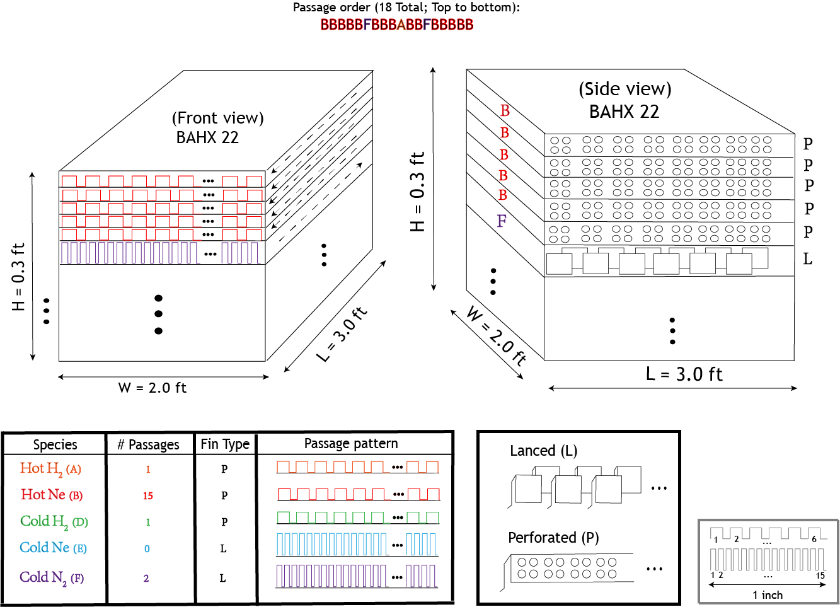
BAHX Design by hand: Heat Exchanger 22

Slide 67
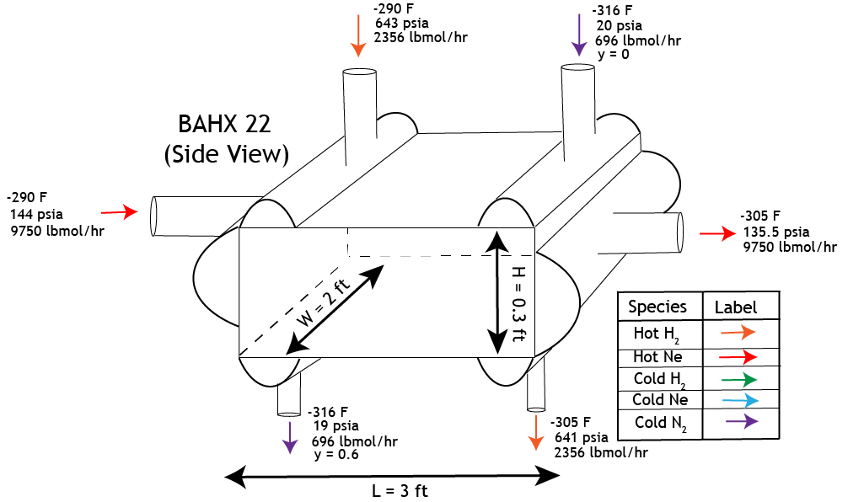
BAHX Design by hand: Heat Exchanger 22

Slide 68
Configuration for single operation plant.
More likely to be designed into multi-function energy plant.

Slide 69
Inaccurate heat capacity (C_{p}/C_{v}) ratio messes up equipment sizing
C_{p}/C_{v} ~ relative amount of heat lost to expansion when a substance is heated
Heat Exchangers
$${\left(ΔP\right)}_{PR}>{\left(ΔP\right)}_{NIST}$$
50% C_{p}/C_{v} (PR) causes Lower P_{out}
Refrigerant recycle
compressor
P_{in} = 133 psia
Refrigerant turboexpanders
P_{out} = 150 psia
(Specified Pressure Drops)
Abridged version of process flow diagram, with hydrogen as selected refrigerant
For this reason, REFPROP Databank (NIST) chosen
Notes:
When a substance is heated, its temperature will rise, and it will expand. Cp/Cv (heat capacity ratio) illustrates the relative amount of heat that is lost to expansion when a substance is raised to a certain temperature. An inaccurate Cp/Cv ratio will create inaccurate compressor and expander power requirements, messing up equipment sizing and design.
In our process, the refrigerant enters the turboexpanders at a pressure of around 133 psia.
A 50% lower C_{p}/C_{v} from PR EOS causes the outlet turboexpander pressure to be lower than it should be. This stream then works its way through the HXs and reaches the refrigerant recycle compressor. Here, an outlet pressure of 150 psia is specified. If the inlet pressure to the compressor is lower than it should be, the compressor will have to do more work.
Refrigerant recycle compressor is most expensive unit operation in process and such deviations have significant implications for cost. For this reason, REFPROP Databank, which references NIST data tables, was chosen.
If questions are asked: “While our final process configuration uses Neon as the refrigerant instead of H2, we wanted working PFD where we wouldn’t have to switch EOSs to assess different cases.”

Slide 70
By-Hand Design of in-process BAHXs is necessary [1]
BAHXs 26 and 30 packed with Fe₂O₃ catalyst
Complicates the effective heat transfer area
Complicates effective heat transfer coefficient
Increases the pressure drop over the BAHX
(Sample diagram of a BAHX with the passage where hot hydrogen flows packed with Fe₂O₃ Catalyst. Fluid flow directions are indicated with dotted arrows)
= Fe₂O₃ catalyst
(BAHX design in conceptual liquefaction plants not discussed)
Notes:
Script:
The brazed aluminum heat exchangers were designed according to an algorithmic method taught to us by Professor Leonard Fabiano. The details are not too important. One important detail to remember is that the pressure drop of streams along the length of the heat exchanger is informed by

Slide 71
By-Hand Design of in-process BAHXs is necessary [2]
ASPEN Plus requires user to estimate pressure drops for each HX
Finding the optimal pressure drop is complex
1) Lower ∆P → Lower Neon recycle compressor Power requirement
2) Lower ∆P → Lower heat transfer coefficient
These effects compete

Slide 72
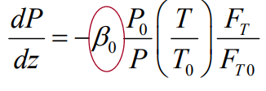
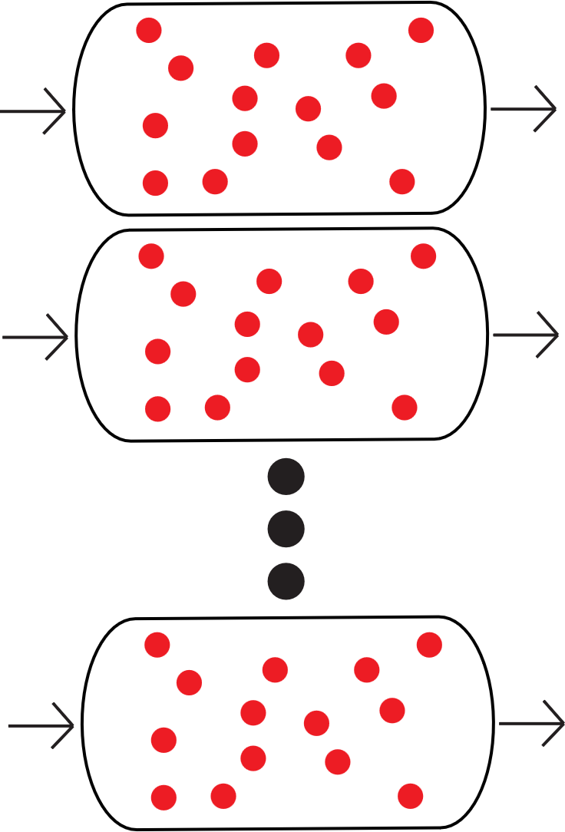
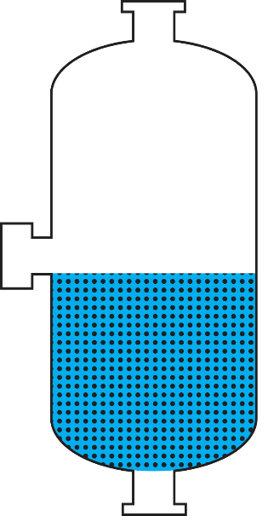
PBR Model of HX 26, 30 & Knock-Out Drum
$$f\left(X_{i},k\left(T\right),y_{o−{H_{2}}_{eq}}\left(T\right)\right)$$
constant
captured from ASPEN HX report
Donaubauer et. al
Physical properties of catalyst, $\dot{m}$ of bulk gas through passage
Catalyzed Passages
Catalyzed bed
https://onlinelibrary.wiley.com/doi/full/10.1002/ceat.201800345
Notes:
Evan -
To confirm conversion assumptions within the heat exchangers and knock-out drum of the process, a Packed Bed Reactor model was employed using literature kinetic reports on our chosen catalyst, Ionex, catalyst property specifications provided by the catalyst vendor, Molecular Products, and discrete stream temperature values recorded along the length of the exchanger from ASPEN models considering the heat of reaction and heat removal from the stream system. In the case of the heat exchanger, catalyst is filled completely between fins of each passage. The void space between each fin is therefore considered as an individual PBR, with the entire passage modeled as a parallel system of reactors. The Knock-Out drum, on the other hand, has two phases. The gas phase leaves the drum without interfacing with the catalyst bed, while the liquid phase drops through a cylinder of catalyst powder before entering cryogenic storage.

Slide 73
Modeled PBR conversions match assumed conversions
Heat Exchanger 26
Heat Exchanger 30
Modeled Distribution
Actual Distribution
Notes:
Evan -
Short Version, If Time Is Not Allowed: A detailed PBR model was produced for both heat exchangers 26 and 30, showing exit compositions of 65 and 97% para hydrogen, respectively. Heat exchanger 26 exhibits a high conversion and heat load within the first foot of its length, requiring an adjacent heat sink for even temperature distribution. Heat exchanger 30's composition change remains relatively linear across the length of the exchanger, showing the heat leak assumption discussed before as a viable solution to our modeling difficulties.
Detailed Version, I Would Prefer To Do: Heat exchanger 26 is modeled as having an entering concentration equal to that of the process feed, 25% para hydrogen, and exit concentration of roughly 65% para hydrogen. The red curve demonstrates the model when assuming a circular area for each space between fins, to align better with the PBR model. The blue curve represents the total cross-sectional area caused by passage fin geometry, here assumed to be sinusoidal. Fluid flow patterns along this complex geometry are not considered due to the small passage size and turbulent flow regime. Between the two curves, conversion change across the exchanger length is nearly identical. An important phenomenon to observe in this graph is the inlet concentration at Heat Exchanger 26. Here, feed hydrogen enters at approximately normal hydrogen composition, and due to a large gap between actual and equilibrium composition, reacts at a faster rate than any subsequent length increment of the exchanger. In reality, such a fast reaction would lead to a large heat release in this section of the heat exchanger that our model does not directly account for. Without any heat removal, this section would result in temperature rising by approximately 10 degrees. However, adjacent cold streams are designed to absorb the total heat of reaction across their length of the reactor. This section may decrease the exchanger efficiency marginally, and could be resolved by the addition of a cold sink at this section of the exchanger, but overall exchanger sizing and performance is not expected to change significantly. Another resolution to this complication that may be worth future investigation is the packing of catalyst at the end of Exchanger 22.
Heat exchanger 30 on the other hand, with an entering feed composition closer to the equilibrium hydrogen composition at its entering temperature, linearly distributes conversion across the length of the exchanger, thus linearly distributing heat in line with the Aspen model, with some tapering in reaction rate at the end of the reactor.

Slide 74
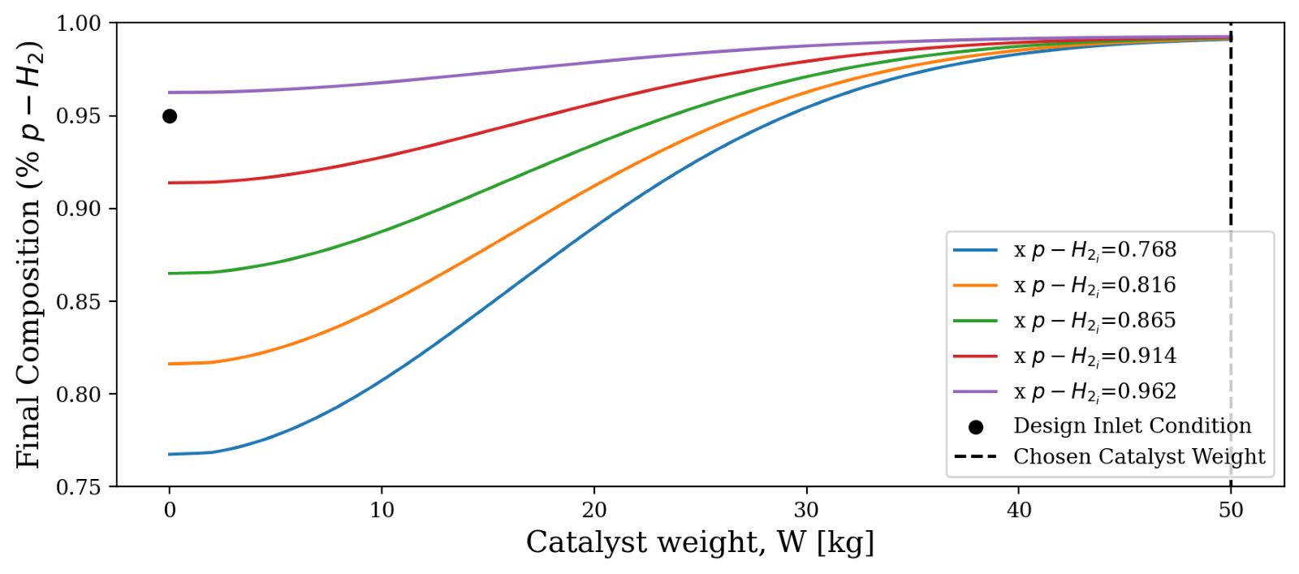
Catalytic Knockout Drum – Filled To Resolve Variable Inlet Concentration
*large variations from inlet design p-H₂ concentration will result in increased recycle stream flow, potentially exceeding HX 30 and 26 cold H₂ load specifications, causing shutdown.
*critical that process equipment is well-maintained
Notes:
Evan -
The hydrogen stream enters the knockout drum at -414 Farenheit, where the gas phase is sent to the recycle stream as a cold fluid and the liquid phase passes through a packed bed of hydrous ferric oxide. Due to the low cost of knockout drums, there is a fair flexibility in sizing this unit. As such, sufficient catalyst has been designed into the liquid phase to fully react a large variety of inlet concentrations. This ensures the downstream storage tank is not contaminated with low-purity hydrogen which could cause explosive hazards for consumers, at the cost of an increased vapor flow rate out of the drum caused by reactive evaporation. Elevated vapor flows could cause unwanted high mass velocities through the cold hydrogen passages of heat exchangers 18 through 30, and thus the process must be carefully monitored to avoid safety hazards.

Slide 75
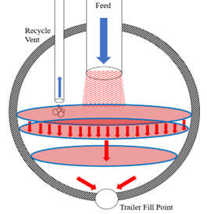
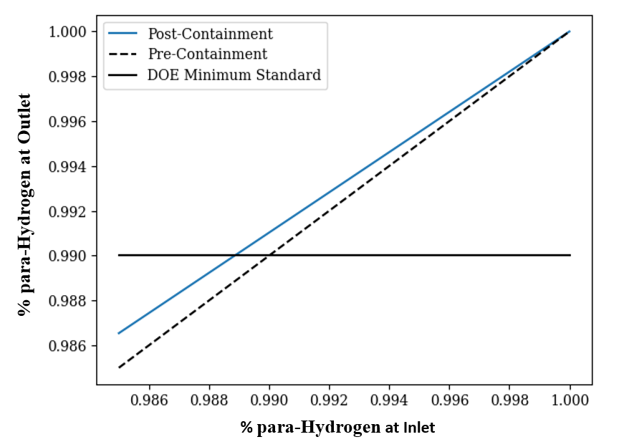
Storage Unit – Residual Conversion and Delivery
Notes:
Evan -
The cryogenic storage tank, per recommendations from our advisors, is configured to be capable of storing 7 days worth of production, but is expected to hold between 3 and 4 days of production on a normal operating schedule. Since the storage tank is also the hopper for hydrogen delivery to trailers and rail cars, the expected residence time of a unit volume of hydrogen is approximated at 3 days. Using this assumption and literature approximations on spontaneous conversion kinetics between ortho and para hydrogen, a curve comparing pre-containment to post-containment product concentration is plotted to the right, benchmarking the Department of Energy concentration standard at our product temperature. Conversion in tank and heat transfer from the atmosphere leads to a constant but insignificant evaporative rate that is removed from the tank and returned to the feed stream.

